Slide 1
Channels
The most talked about C of the #5CsofSocial Chapter 7
www.amazingSMstrategy.com • #5CsofSocial

Slide 3
Agenda
Definition and examples
How do channels influence messages?
What are some channel dynamics?
How do I select the best channels?

Slide 4
1. Definition and examples
What are communication channels?
Mediums through which our messages pass to reach others
Examples:
Memos, face-to-face communications
Email, website
Social media platforms

Slide 5
2. How do channels influence messages?
Principle - Every channel uniquely influences messages
Influences:
Type of signals that can be sent
Accuracy or fidelity of transmissions
Amount or capacity of information transmitted

Slide 6
3. What are some channel dynamics?
Principle: Unique dynamics emerge from a channel’s
physical constraints
cost/benefit structure
usage patterns
What do we mean by channel dynamics?
the range of possible and typical actions
conventions
customs
norms
For example:
channel constraints (Twitter)
cost/benefit structures (TV vs. social media advertising)
usage patterns (Twitter)
Notes:
Channel constraints: for example, with Twitter most messages are consumed within 17 minutes of posting or not at all
Cost/benefit structures: TV advertising is more costly than social media advertising
Usage patterns: Twitter is seen as an information stream while Pinterest is seen as an information resource

Slide 7
Examples of channel dynamics

Slide 8
4. How do I select the best channels?
To get started…
Cast a wide net of inquiry
Think in terms of platforms you will actively manage and those you will passively manage
Develop “job descriptions” for each channel
Ensure that the channels advance your strategic goals (coordinates) and your target audience’s preferences
Notes:
See the book and website for details (website has platform-specific infographics)

Slide 9
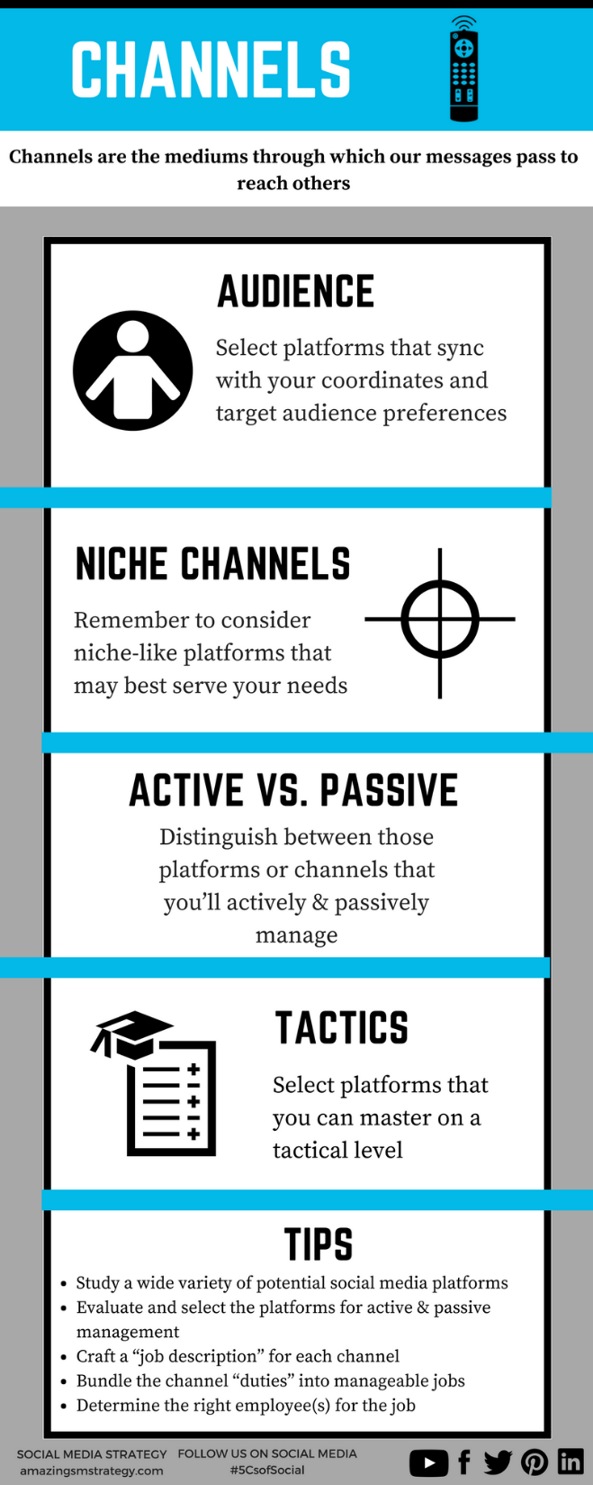
Tips and reminders
Notes:
These infographics are also available on the book’s website under the “Fun” tab

Slide 10
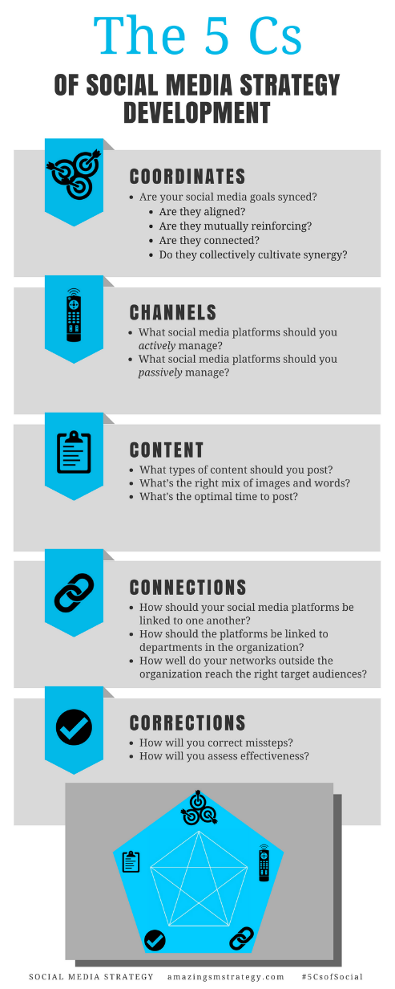
The 5 Cs of Social

Slide 11
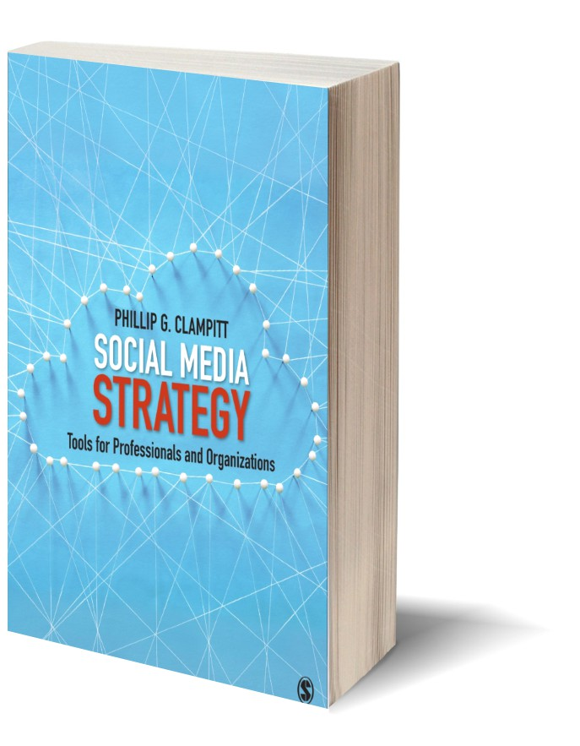
Social Media
Strategy
Tools for Professionals and Organizations
#5CsofSocial

