Slide 1
The Social Media Cosmos
Chapter 4

Slide 2
Agenda
Functional perspective
Dynamics perspective
Experiential perspective

Slide 3
Overview

Slide 4
1. Functional perspective
ML + - Thinking
Thinking routine
Most like
Plus what key feature
Minus what key feature
Cautions
Minus does not mean “bad”
Audience comparison points shift
Time changes the comparison points

Slide 5
Plus/Minus thinking
What is the value of this kind of thinking?
Simplifies the complex and confusing
Educates
For example:
Explain a pencil to an artist who has never used one
Explain a car to someone who has never seen one
Explain a social media platform to a manager who isn’t familiar or on board with social media

Slide 6
Plus/Minus thinking: Questions to ask
ML: What is the unknown phenomena most like?
Plus: What added feature makes it different than the known phenomena?
Minus: What missing feature makes it different than the known phenomena?
Notes:
Regarding the minus component: reiterate that: 1) it does NOT equate to a negative, and 2) it’s not a pro/con type of analysis…the phenomena is most like something PLUS some features and MINUS other features

Slide 7
A pencil is most like…
Pencil (the word is derived from the Middle English word, pencil, which meant: “artist’s brush”)
A pencil is most like:
“A brush that maintains a constant flow of paint minus all the hassles of managing a color palette and paint mess.”

Slide 8
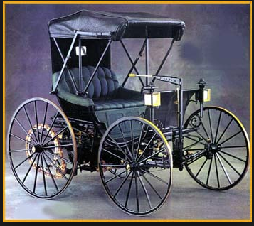
Other examples
Using the ML + - thinking, how would you describe the following?
Horseless carriage
Mobile phone
Electric car

Slide 9
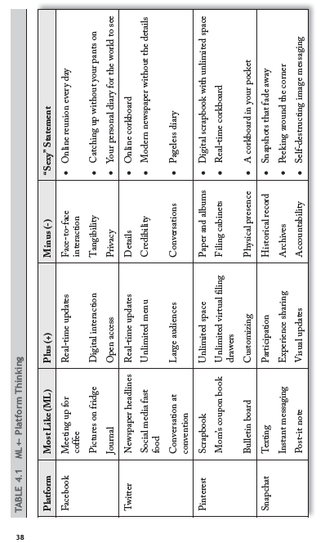

Slide 10
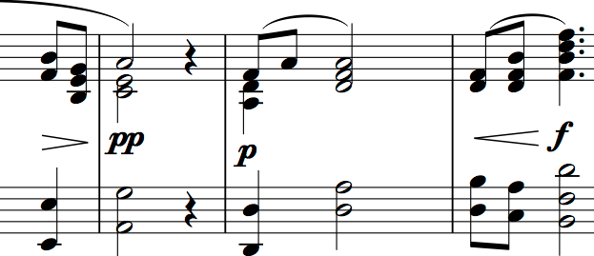
2. Dynamics perspective
What is it?
Not an “attribute”
An attribute is an inherent characteristic or capability
For example:
notes on a musical score
characteristic of a platform
But “dynamics”
Dynamics are usage patterns -- how people typically make use of something (or how they play the music)
Example:
phrasing on a musical score
how people make use of a platform

Slide 11
Definition of social media dynamics
Time Sensitivity – How important is the timing of the post?
Source Credibility- How important is the credibility of the source making the post?
Receiver Location – How important is the geographic location of the followers?
Category Choice – How important is it to select the right category within the social media platform?
Word Selection – How important are the words chosen in the post?
Image Choice – How important are images in the post?
Information Utility – How important is the utility of the information provided in the post? Is it something followers can use in their life? Is it something they are interested in?
Emotional Impression – How important is the emotional impression of the post? Does it make followers laugh? Cry?
Audience Size – How important is audience size for the typical user?

Slide 12
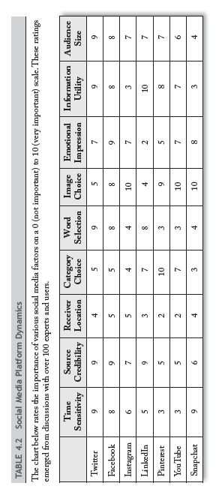

Slide 13
3. Experiential perspective
Notes:
See p. 42-45 for details

Slide 14
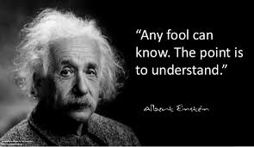
“Many people intuitively understand the ‘social’ dimensions of social media, some appreciate the ‘media’ properties of social media, but only a few fully fathom the unique synergistic possibilities and perils of combining social sensibilities with media capabilities.”
—Dr. So What

Slide 15
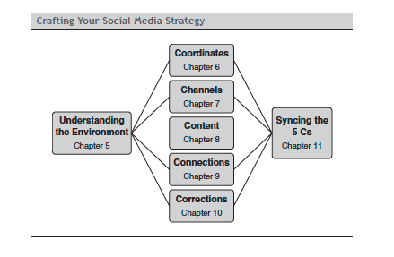
Notes:
This slide previews the next section of the book

Slide 16
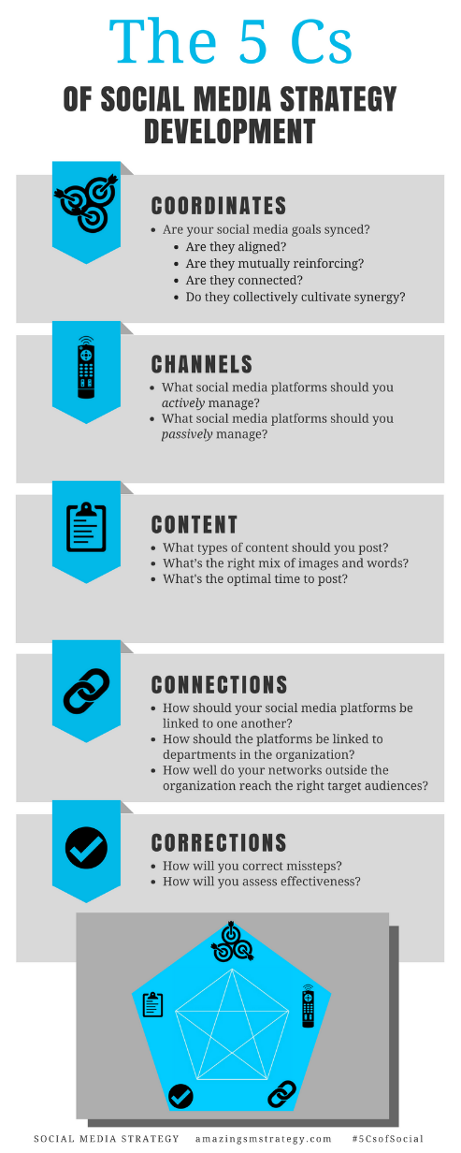
The 5 Cs of Social

Slide 17
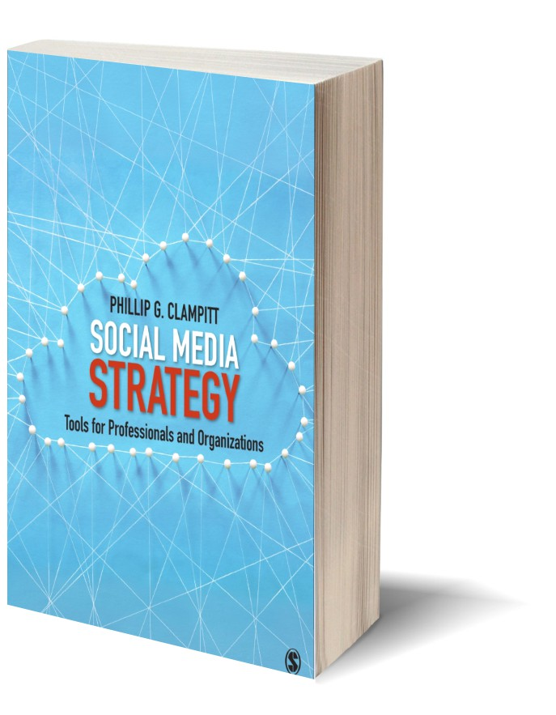
Social Media
Strategy
Tools for Professionals and Organizations
#5CsofSocial

