Slide 1
Content
The most visible C of the #5 Cs of Social
Chapter 8

Slide 3
Agenda
Definition and basic considerations
What are my content options?
Who generates the content?
How do I select great content?

Slide 4

1. Definition and basic considerations
What is content?
  The words and images you choose for your posts, tweets, etc.
What are some basic considerations?
  Form – pictures, text, videos, graphics
  Type – news, events, how-to, etc.

Slide 5

2. What are my content options?
Options for type of content:
News & Information
People
Events
Calls to Action
Amusements
How-To
Inspiration
Commentaries & Opinions
Indices – hashtags, links

Slide 6


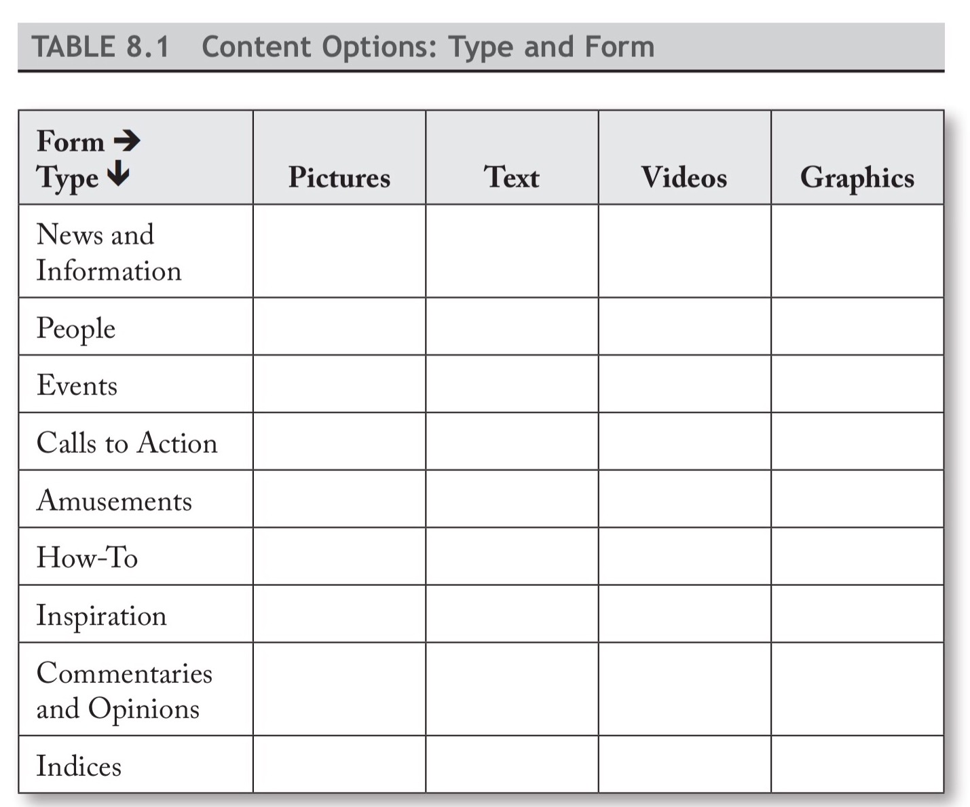


Content options

Slide 7
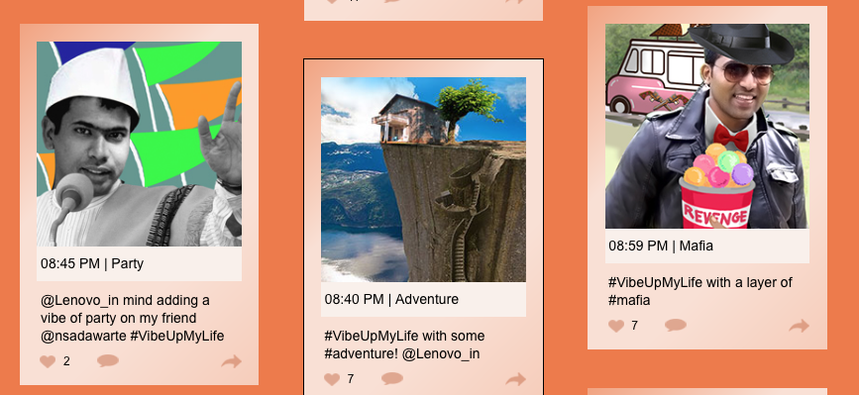
3. Who generates the content?
Internally produced
Curated
User-generated
Co-created
  For example, the phone producer, Lenovo, commissioned artwork from 10 artists for its Vibe X2 phone
  #VibeUpMyLife
Notes:
A Lenovo campaign generated enormous interest in India. The images are from the campaign.

Slide 8
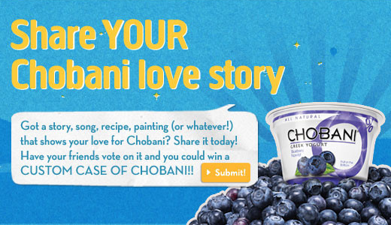
User-generated
Is powerful
Taps into people’s inherent desire to be recognized and/or appreciated
Chobani, a Greek yogurt company, used its customer base to improve its image and boost sales. The company asked its
loyal customers to submit videos and images praising its yogurt. The content was shared on the company website, billboards,
and across other mediums.

Slide 9
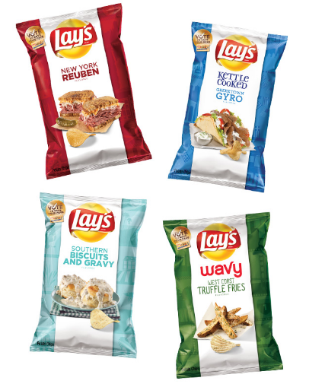
Lay’s “Do us a flavor!”
Customers asked to submit their ideas for the next potato chip flavor
Vote held
Winner received $1 million or 1% of the flavor’s net sales over the next year, whichever amount is higher
Crowdsourcing/Hybrid

Slide 10
Benefits/Concerns
Options for Generating Content: Benefits and Concerns
 | Internally produced | Co-created | Curated | User-generated
Benefits | Maximizes control Allows for customization Encourages creativity
Concerns | Requires expertise Takes time and effort to produce Is expensive to generate
Notes:
Fill in the blanks for discussion purposes

Slide 11
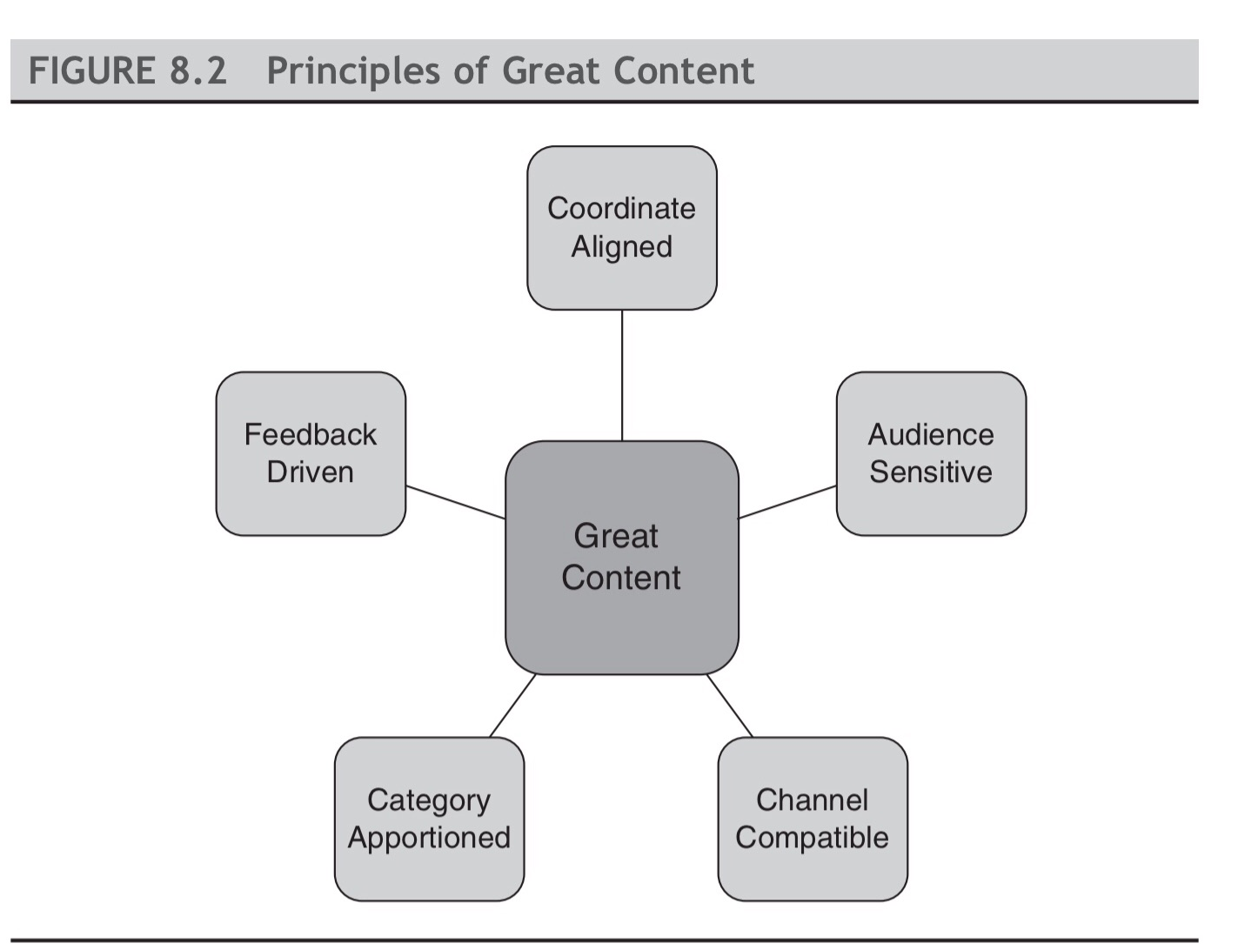
4. How do I select great content?
Notes:
See book and website for details

Slide 12

a. Coordinate aligned
Will this content help advance our business and communication goals?
Potential challenge – Coordinates may push you in different directions
  Maintain customer loyalty
  Expand customer base
  “Sorry for your loss” example
Notes:
This announcement was sent to thousands of customers to promote a product. When the recipient clicked on it, it showed “sorry you lost out on our great deal.” It did promote more engagement but inevitably some receivers had recently experienced a personal loss and were offended. A few pulled their accounts from the company.

Slide 13

b. Audience sensitive
B2B vs. B2C vs. B2E
Crown your audience “Kings” or “Queens”
What do you need to know about the audience? (see next slide)
Notes:
Business 2 business or business to consumer or business to its employees

Slide 14
Audience Questions
What
  What keeps the audience up at night?
  What do they find funny?
  What kinds of material do they post?
  What are their underlying motivations for monitoring social media?
  What they would find surprising?
  What they would find intriguing or useful?
Who
  Who do they find credible and/or funny?
  Who are the opinion leaders in the audience?
  Who would be the worse source of information?
  Do they prefer pictures, text, videos, and/or graphics?
Where
  Where do they use social media?
  When do they consume social media on particular platforms?
  How do they access social media? (e.g., phone, computer, etc.)
Key audience questions

Slide 15

c. Channel compatible
Think how radio, TV, and print ads differ for the same product
Craft content that resonates across platforms, while respecting the unique dynamics of each platform.
  Rihanna
    Instagram for glamour shots, like poses in a jeweled bikini with feathers
    Snapchat for more every day sides of her personality, like a video clip of her killing a bug in a hotel room
Notes:
An ad that would work on radio may not work on TV

Slide 16
Channel compatible
Facebook tips
Short text
Provocative, entertaining, or surprising
Highly visible photo (mobile devices)
Visible logo
Pinterest tips
Pictures feed “the dream”
Boards with clever titles
Photos hyperlinked
Easily categorized content
Look like an ad in top-flight magazine
79% more likely to purchase something from Pinterest than from a Facebook pix

Slide 17
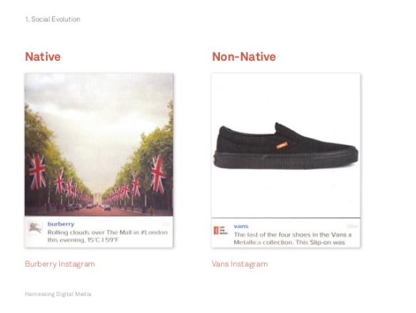
Platform native
Instagram
Each platform has its own language, culture, sensibility and style
What works for one may not work for another

Slide 18
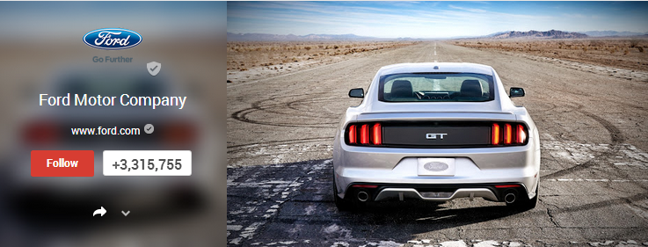
A Pinterest fail
Notes:
Why might this not work on Pinterest but might work on another platform?

Slide 19
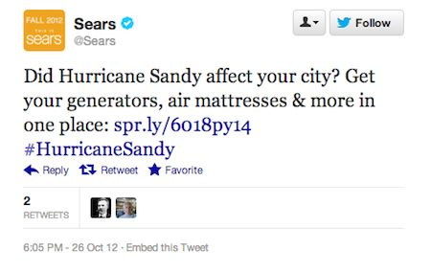
Channel details that matter
Shorter posts tend to garner more “likes” and sharing than longer ones
Using VIPs in your videos boosts appeal
Compelling content can be produced by professionals or amateurs. It doesn’t really matter as long as it’s surprising, funny, or joy-inducing
Content that emphasizes authenticity, community pride, identity with common values, and fun tends to build stronger engagement
Cautionary note
Notes:
Cautionary Note: The details are always changing because platform providers are always tinkering with the formulas and algorithms

Slide 20
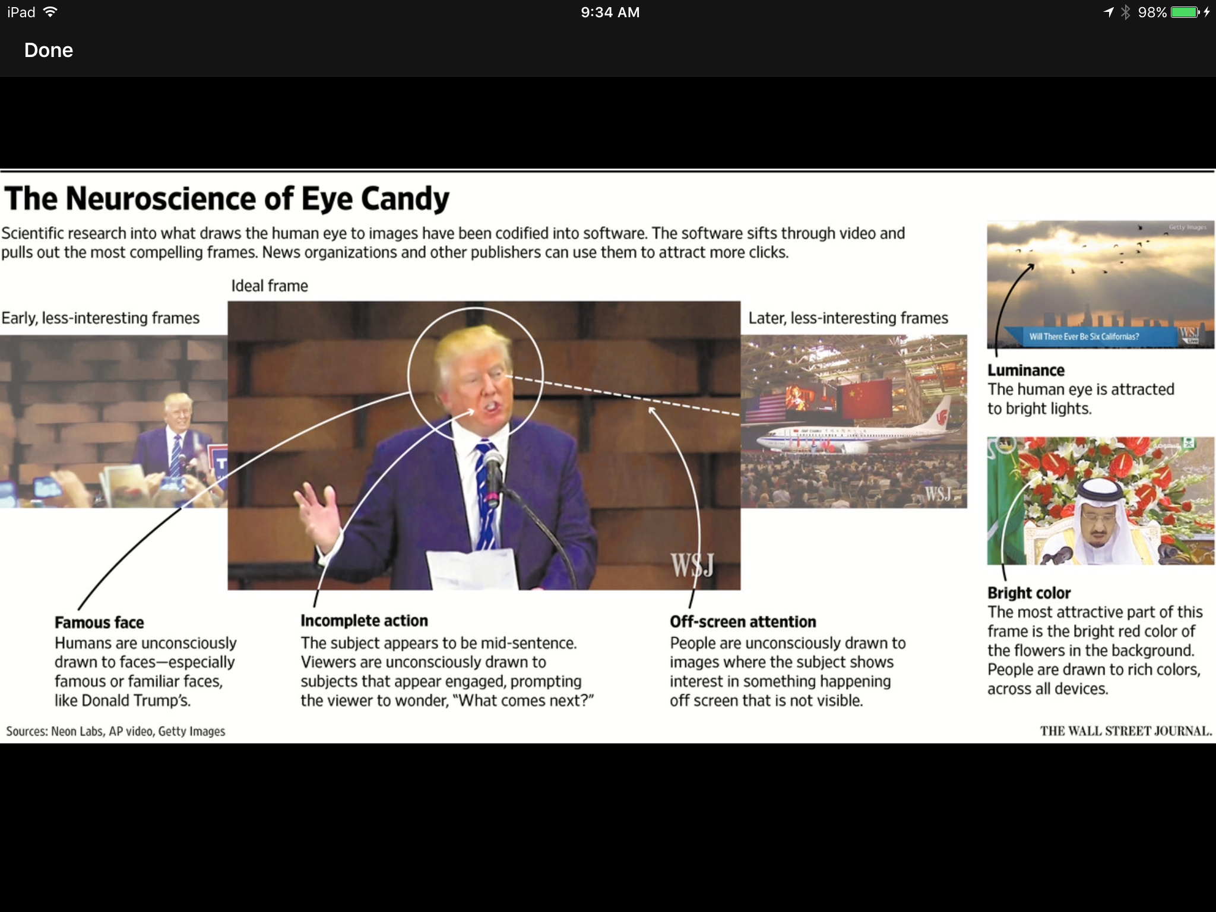

Slide 21
d. Category apportioned
Power of categorical lens – Think measuring ingredients for a soup
Jab, jab, jab, right hook
  Jabs are lightweight pieces of content that benefit your customers by making them laugh, snicker, ponder, play a game, feel appreciated, or escape; right hooks are calls to action that benefit your business
Avoid total randomness AND total predictability

Slide 22
Example of category mix

Slide 23
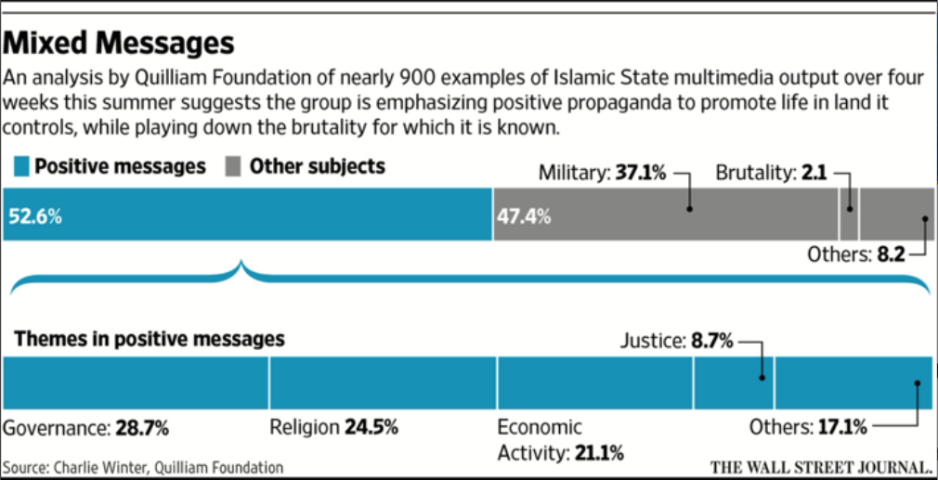
ISIS Social Messaging during War
ISIS Social Messaging during Occupation

Slide 24

e. Feedback driven
Strong signals
Weak signals
  What surprised us this week?
  What emerging trends do we see outside of networks?
  What data trends do we notice that suggest we need to tweak our approach?

Slide 25
Feedback-driven renewal
Mentions
Likes
Click-throughs
Comments
Shares
Followers
Retweets
Inbound traffic
Downloads
Traffic volume
Time to reply
Fans
Available feedback metrics

Slide 26

Weighting issues – How much do you weight certain items in your formula?
Denominator issues – What should be your denominator?
  Day
  Post
  Update
  Category
Timing issues – How much time do you need to see if a post works?
Sampling issues – What kind of sample is sufficient to make useful judgments?
Formulas
Notes:
You can use a variety of formulas to generate useful feedback about the performance of your social media. These are some of the issues you need to consider when creating formulas.

Slide 27
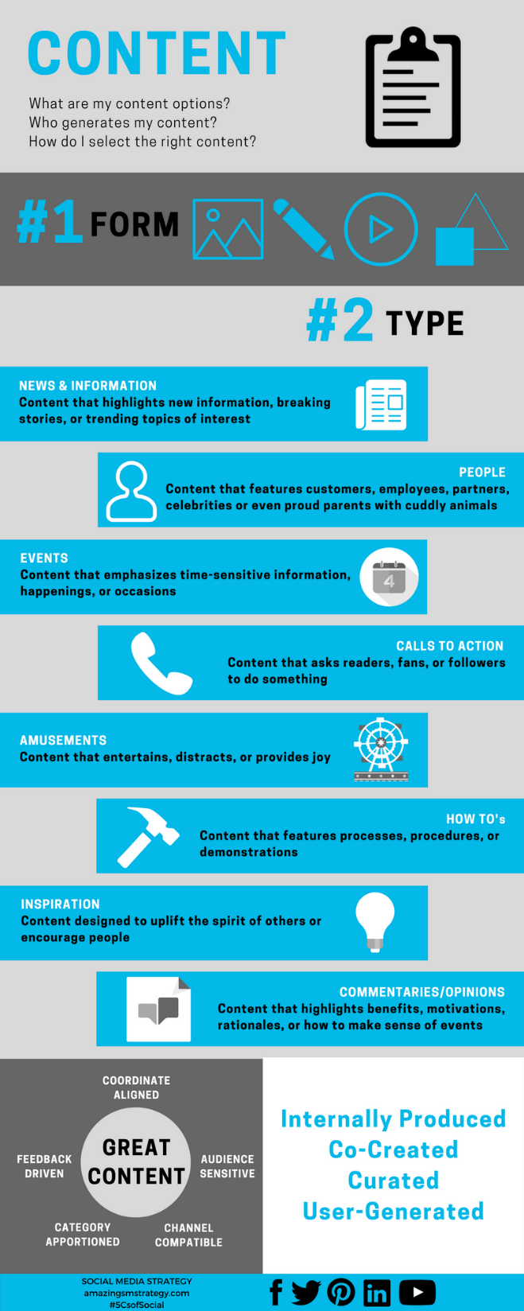
Tips and reminders
Notes:
These infographics are also available on the book’s website under the “Fun” tab

Slide 28
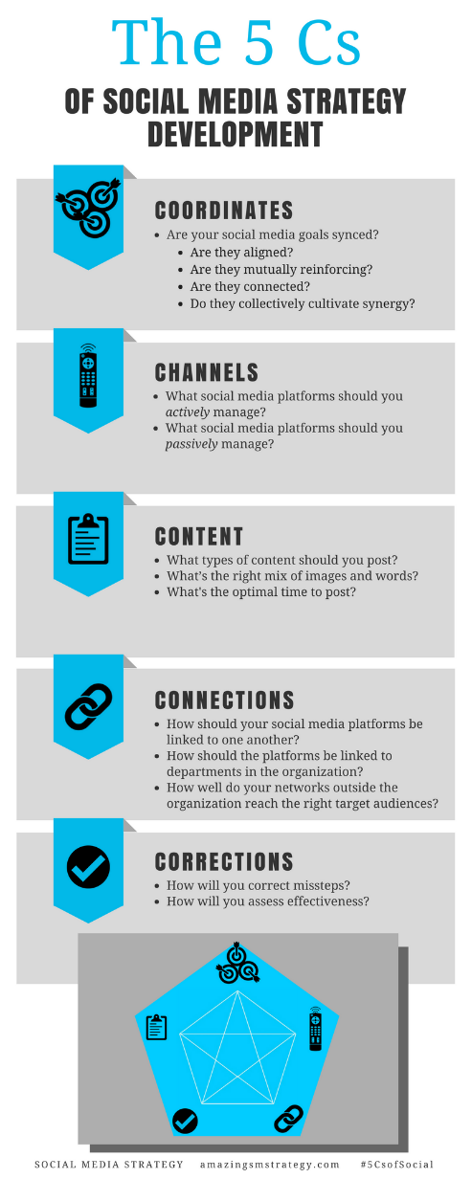
The 5 Cs of Social

Slide 29
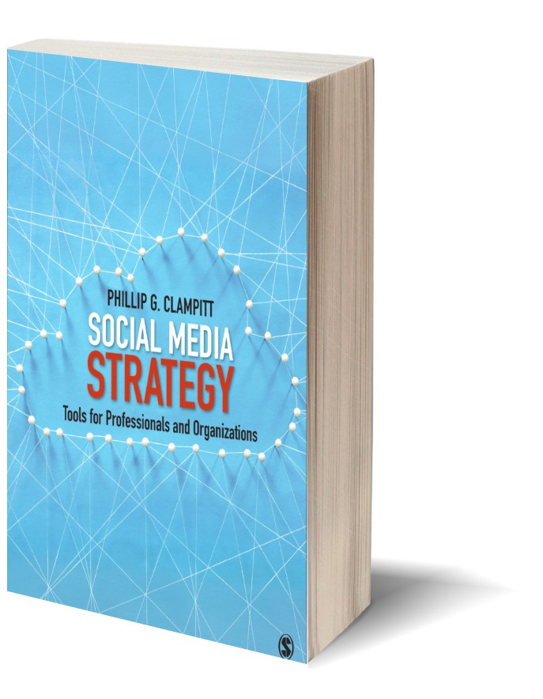
Social Media
Strategy
Tools for Professionals and Organizations
#5CsofSocial

