Slide 1
Syncing the Strategy Dots and Crafting Action Plans
Chapter 11

Slide 2
Agenda
Test 1: The Coordinates Test
Test 2: The Synergy Test
Test 3: The Translation Test

Slide 3
Test 1: The Coordinates Test
Coordinates
Channels
Corrections
Connections
Content
Notes:
Note: Figure 11.1 in the book

Slide 4
The Coordinates Test
Your goal: increase your target audience’s attendance at your event
Can you answer “yes” to:
Do your channel selections, content choices, connection choices and correction plan match up with your coordinates (i.e., increase your target’s attendance at your event)?
Coordinates > Channels test
Coordinates > Content test
Coordinates > Connections test
Coordinates > Corrections test

Slide 5
Test 2: The Synergy Test
Coordinates
Channels
Corrections
Connections
Content
Notes:
Each element has to be linked to the others – in that way, they strengthen and reinforce the other (Note: Figure 11.2 in the book)
For example, you have to have the right content for a particular channel

Slide 6
The Synergy Test
Notes:
We did the ”tests” for the Coordinates column with Test 1
Now we apply more rigorous tests: how strong is the relationship between the remaining strategy elements? How do we rate each: “green light” (signals a strong, reinforcing relationship), “yellow light” (signals a cautionary relationship) or “red light” (signals an incongruent or weak relationship)?

Slide 7
The Synergy Test
Channels > Content test
Are the channels aligned with your content/message choices?
Channels > Connections test
Are the channels aligned with your connection decisions?
Channels > Corrections test
Are the channels aligned with your correction plan?
Content > Connections test
Is your content/message choices aligned with your connection decisions?
Content > Corrections test
Is your content/message choices aligned with your correction plan?
Connections > Corrections test
Are your connection decisions aligned with your correction plan?

Slide 8
Test 3: The Translation Test
Notes:
This step helps you translate your strategy into action plans and tactics
After ”green lighting” Tests 1 and 2, you’re ready to address the specifics (note: downloadable version of Table 11.2 is available on the book’s website)
-in column one, list the coordinates of your strategy
-in column two (Other Strategic Elements), indicate the associated channel/content/connection/corrections elements associated with each
-in column three (Tactics), detail what needs to be done, who will be responsible, when it will be done, etc.

Slide 9
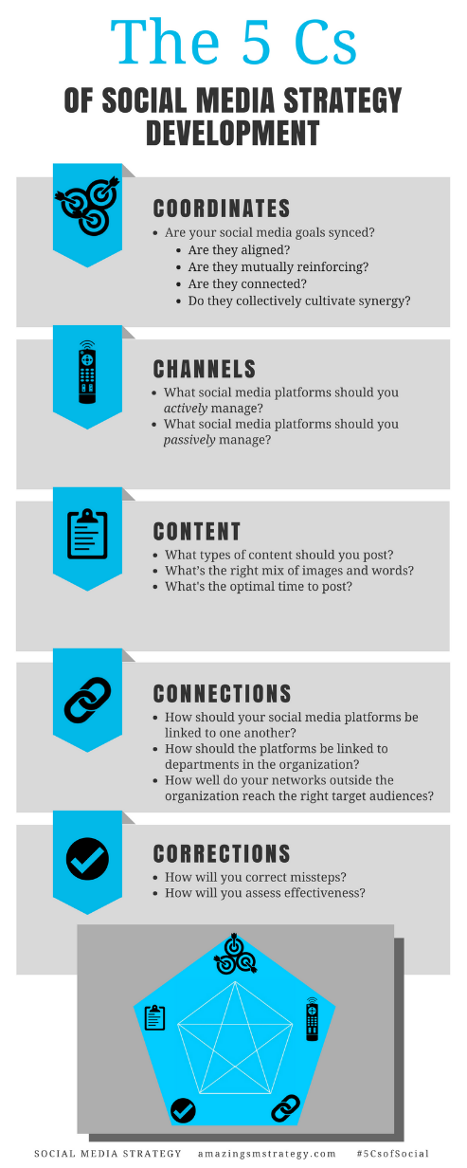
The 5 Cs of Social

Slide 10
Social Media
Strategy
Tools for Professionals and Organizations
#5CsofSocial

