Slide 1
Who Needs a Social Media Strategy?
Chapter 1

Slide 2
Agenda
What is social media?
2. Who can benefit from a course in social media strategy?
3. How can they benefit from a course in social media strategy?
4. What are the goals of the course?
5. What principles guide the course?

Slide 3
1. What is social media?
electronic form of communication
governed by the rules of platform providers
which allows users to share images and text within their selected communities

Slide 4
2. Who can benefit from a course in social media strategy?
Professionals
PR
Marketing
OrgComm
Journalists
Health Comm
Mass Comm
Sports Comm
Organizations
Profit
Non-profit

Slide 5
3. How can you benefit from a course in social media strategy?
Re-orients the focus from a user to a professional
Helps you make better use of scarce resources
Alerts you to potential social media minefields

Slide 6
4. What are the goals of the course?
Understand the underlying dynamics of social media platforms
Identify the characteristics of effective and ineffective strategies
Design strategies and tactics to create social media success
Evaluate existing social media strategies and tactics

Slide 7
5. What principles guide the course?
Strategic insights are fundamentally different than tactical insights
Readings
Feedback from professor and colleagues
Analytical experiences help develop the strategic mindset
Deep Dives
Projects
A useful framework can guide inquiry and help develop a strategic mindset
5 Cs (content, coordinates, channels, connections, corrections)
Assessment Process (see next slide)
Notes:
Having a strategic orientation is a more enduring approach to decision-making and problem solving. There are many ways in which the course helps develop a strategic, big-picture mindset in approaching social media decisions:
The readings and feedback from the instructor and colleagues;
The Deep Dives and projects provide opportunities to apply the principles;
Frameworks, such as the 5 C model and the 4-step Assessment Process (Chapter 13), provide a structure that orients thinking on factors of significance

Slide 9
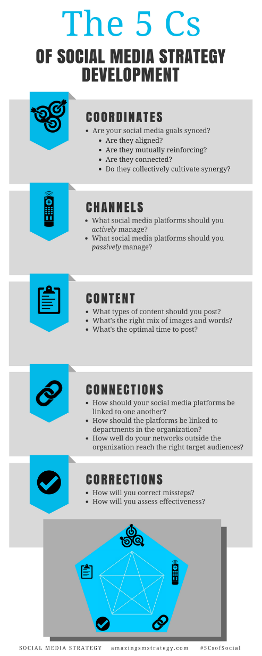
The 5 Cs of Social
Notes:
These infographics are also available on the book’s website under the “Fun” tab

Slide 10
Amazing Social Media Action Steps
Use the tools available on the website to maximize your effectiveness
Follow us and connect with our SM Strategy Community
Read about worldwide SM scholarship on our website
www.amazingSMstrategy.com

Slide 11
Social Media
Strategy
Tools for Professionals and Organizations
#5CsofSocial

