Slide 1
Developing the Assessment Protocol
Chapter 12

Slide 2
Part III: Assessing results

Slide 3
Agenda
What types of organizations, people and entities need to evaluate their social media strategy?
How can we use the 5 Cs to evaluate a social media strategy?
What social media strategy arguments might you need to address during an assessment?
What are some typical assessment gaffes?

Slide 4
1. What types of organizations, people & entities need to evaluate their social media strategy?
Organizations
Profit
Non-profit
Individuals
Thought leaders
Celebrities
Products

Slide 5
2. How can we use the 5 Cs to evaluate a social media strategy?

Slide 6
Notes:
See book for details

Slide 8
3. What social media strategy arguments might you need to address during an assessment?

Slide 9
4. What are some typical assessment gaffes?
Focusing on only one or a few metrics
Neglecting to identify underlying actionable issues
Failing to take the situation into account
Notes:
See details in the book. Note that many of the items on the previous slide (Social Media Strategy Arguments) can be added to this list (for example, assuming that because a competitor is on a particular platform that you have to be on it, too)

Slide 10
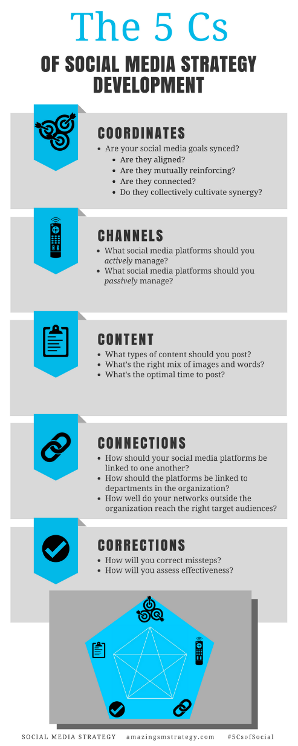
The 5 Cs of Social

Slide 11
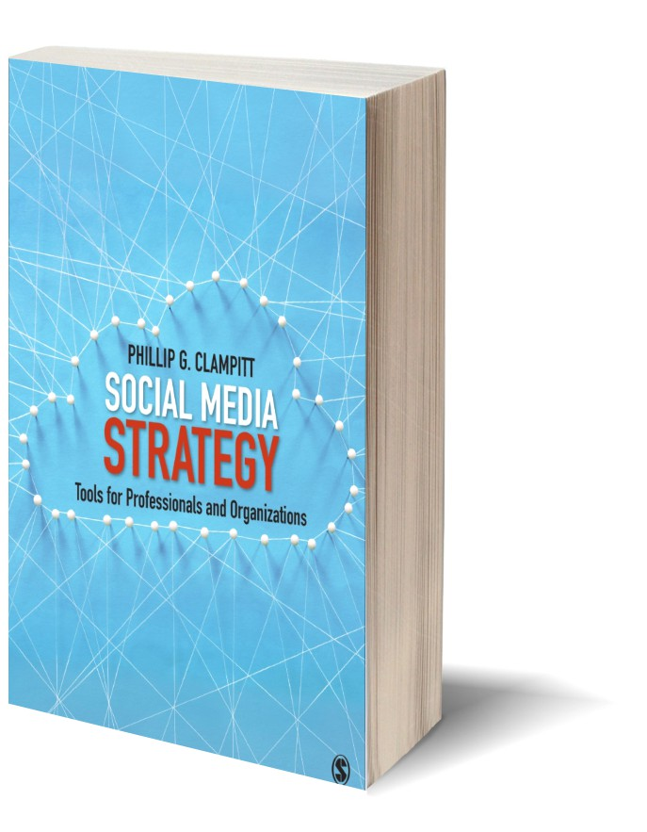
Social Media
Strategy
Tools for Professionals and Organizations
#5CsofSocial

