Slide 1
Corrections Chapter 10

Slide 3
Agenda
What are some sources of errors?
The Corrections Matrix
What does the Corrections Matrix suggest we do?
“Errors that are obvious to others can be invisible to us, no matter how hard we try to spot them.” – Joseph Hallinan

Slide 4
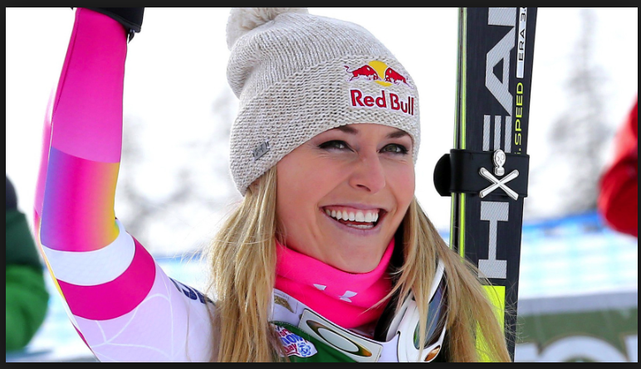
1. What are some sources of errors?
Attention
“We simply can’t pay attention to everything, evn in a wel riten sentence lke this won.”
We can extract meaning without “painstakingly attending to every letter of every word.”
Speed
Lindsey Vonn’s video of destroying her Head ski bindings

Slide 5
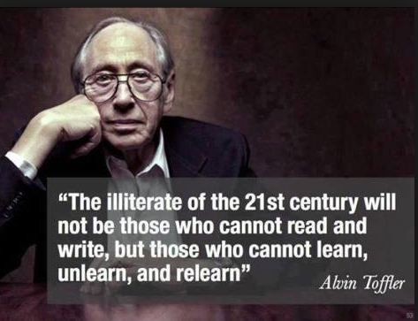
Sources of errors (cont’d)
Habits
Which month of the year do most of the dating errors occur on checks?
“dadada” Mark Zuckerberg
Thinking biases
Example: availability bias
See Table 10.1 for other biases
Dumb ways to die .. Safety on Metro
100 million views .. So what? … Didn’t improve safety—but entertaining (biased thinking)
Dumb Ways to Die video
Organizational structures, procedures, and protocols
Must coordinate these processes
Example: Sales must communicate with customer service, etc…

Slide 6
2. The Correction Matrix

Slide 7
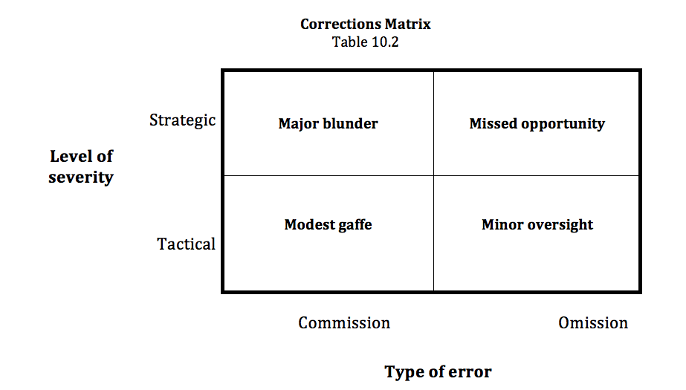
2. Correction Matrix
Major mistakes!
Can damage org’s reputation
Strategic error--harder to correct
Ex: store assumes everyone is on Facebook and overlooks other platforms
Tactical errors of commission – can be corrected quickly
Ex: Facebook shows a product on sale, but store doesn’t have it on sale
Minor tactical errors of omission - can be fixed quickly
Ex: forgetting to add a picture of a product

Slide 8
Major blunder
Major Blunder
“White makes you win” campaign
Notes:
So, let’s see if this qualifies as a “major blunder”…
Here you have a cosmetics company trying to promote it’s skin-lightening products – they sent out a tweet and an accompanying video of the actress on the left proclaiming how her white skin helped her to be successful
I think you’d agree that This kind of blunder is hard to defend on any level

Slide 9
Major blunder or “fail”
United SM Fail video

Slide 10
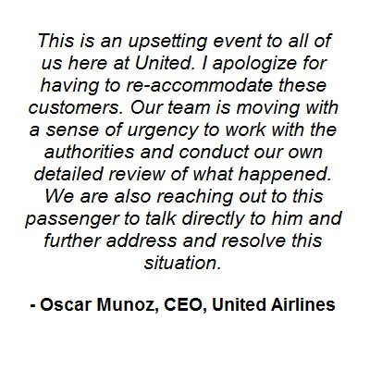
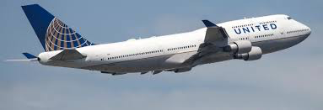
The Friendly Skies?
In March 2017, United Airlines CEO Oscar Munoz was named “Communicator of the Year” by the magazine, PR Week
Public relations experts say the CEO should have quickly offered an unreserved apology
Instead, Munoz apologized only for "having to re-accommodate ... customers"
Top 10 of '16
Notes:
Munoz was named “Communicator of the Year” one month before the “event”

Slide 11
First response-Twitter
First response - Twitter

Slide 12
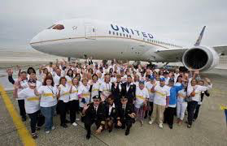
Internal response-employees
In an email to employees, United's CEO Oscar Munoz defended some of the airline personnel's actions, calling the passenger "disruptive and belligerent." He also said that the still unidentified passenger raised his voice and refused to comply with the crew's and security officers' directions.
Internal response to employees

Slide 13
Third time is the charm?
United Airlines CEO Oscar Munoz apologized for the forceful removal of a paying passenger from one of its flights and called the episode "truly horrific."
Munoz pledged a full review by April 30 "to fix what's broken so this never happens again."
"I want you to know that we take full responsibility and we will work to make it right," Munoz said in a statement on Tuesday. "I promise you we will do better."
It was his third attempt to quell growing outrage after a passenger was removed, bloodied and screaming, from a flight that was to take off from Chicago for Louisville, Kentucky. United wanted to give seats to commuting crew members.
In his first statement, Munoz apologized for "having to re-accommodate these customers." In his second statement, he described the passenger as "disruptive and belligerent."
Third time a charm?

Slide 14
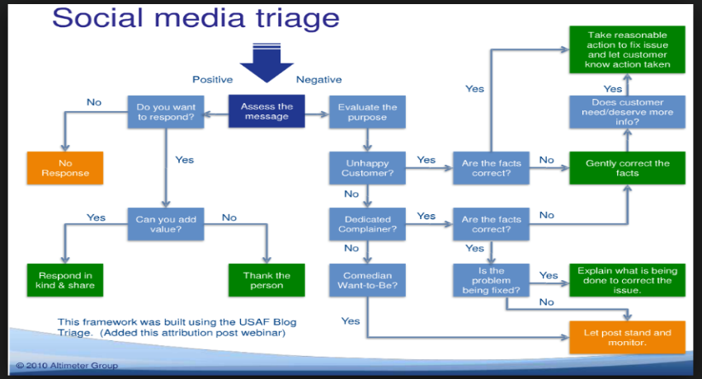
Decision Processes
Lessons learned
Notes:
United should have had a better social media triage system like this one

Slide 15
3. So what does the Corrections Matrix suggest we do?
Detect patterns of error
Keep a log
Connect the dots
Since there are a lot of ways to connect the dots, be careful in your reasoning
Build a great radar screen
Recruit and maintain your own friendly spy network
Build an experimental lab
A/B testing (see following slides)

Slide 16
A/B Testing
Definition: monitoring two versions of the same post to determine which has the most traffic
Testing two different images
Testing two different calls to action
Example: President Obama’s social media requests for donations
First-time donors – “Donate and receive a gift”
Seasoned donors – “Please donate”

Slide 17
A/B testing
Craft a compelling message
Select two different test images – image A and image B
Create a message A by combining it with Step 1 wording and image A
Create a message B by combining it with Step 1 wording and image B
Randomly assign one portion of your audience to Group A; the other to Group B
Simultaneously post message A to Group A and message B to Group B
Monitor results over 24 hours and see which one has the most traffic
Declare a winner
Continue to refine with new wording and images as necessary
A/B Testing Protocol

Slide 19
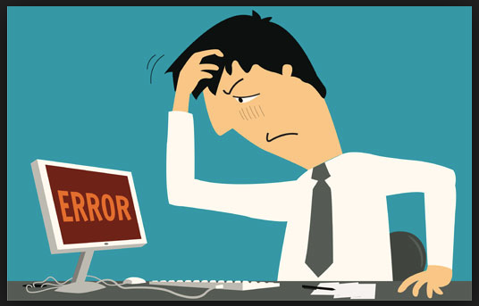
So what does the Corrections Matrix suggest? (cont’d)
Determine what type of corrective action to take
Example: If you receive angry feedback avoid
Underreacting
Overreacting
Set up a regular assessment process to evaluate
Tactical errors
Strategic errors – the 5 Cs
So what does the Corrections Matrix suggest we do? (cont’d)

Slide 20
Concluding thoughts
“Failure is less painful when you extract the maximum value from it. If you learn from each mistake, large and small, share those lessons, and periodically check that these processes are helping your organization move more efficiently in the right direction, your return on failure will skyrocket.”
Julian Birkinshaw, & Martine Haas (May 2016). Increase your return on failure. Harvard Business Review. 94(5), 89 – 93, p. 93.
“Many people have the ability to review something and make it better. Few are able to identify what is missing.” - Donald Rumsfeld
Final thoughts

Slide 21
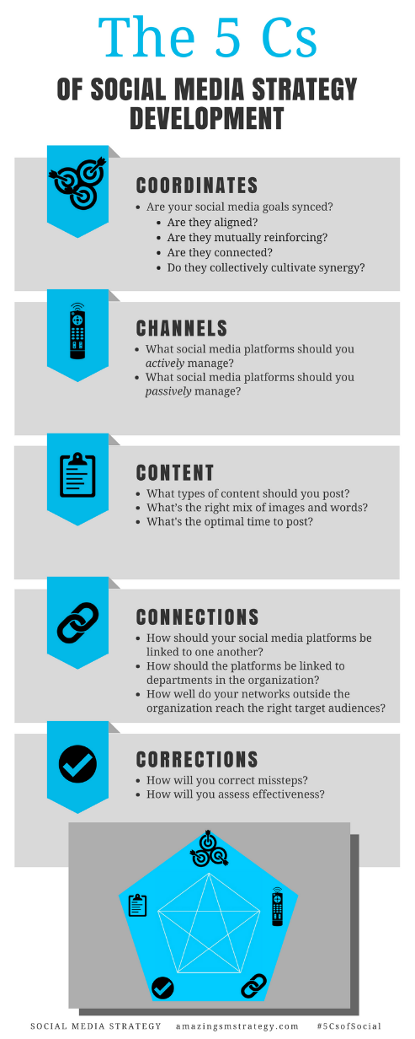
The 5 Cs of Social

Slide 22
Social Media
Strategy
Tools for Professionals and Organizations
#5CsofSocial

