Slide 1
Measuring Social Media Effectiveness
Chapter 13

Slide 2
Part III: Assessing results

Slide 3
Agenda
What are the steps to measure the effectiveness of social media?
Step 1: Master metric language
Step 2: Dive deeper into the measures and analytics
Step 3: Avoid the metric minefield
Step 4: Match metrics with your 5 Cs Assessment Plan

Slide 5
Step 1: Master metric language
Step 1: Master metric language
Notes:
.See book for details
*The Executive Summary was not specifically noted in the book. However, as some executives may not take the time to read the entire report, a one-page summary of the key points of the report is often helpful to include in the beginning of the report.

Slide 6
Master metric language (cont’d)
Audience composition
Demographics
Interests
Influencers
Traffic patterns
Impressions
Reach
Drivers
Master metric language

Slide 7
Master metric language (cont’d)
Engagement measures
Amount of engagement
Intensity of engagement
Community sentiment
Patterns in audiences’
Attitudes
Opinions
Feelings
Emotion
Master metric language

Slide 8
Step 2: Dive deeper into the measures and analytics
Measures not specific to platforms
Word clouds
Hashtags
Platform-specific measures (see next slide)
Step 2: Dive deeper into the measures & analytics

Slide 10
Step 3: Avoid the metric minefield
Resist the seduction of glamour metrics
Don’t assume that metric language transfers across platforms
Be cautious when comparing over time and across organizations
Step 3: Avoid the metric minefield

Slide 11
Step 4: Match metrics with your 5 Cs Assessment Plan
Notes:
Note that the items italicized in Table 13.3 are those that can be measured by specific metrics

Slide 12
Match metrics with your 5 Cs Assessment Plan

Slide 13
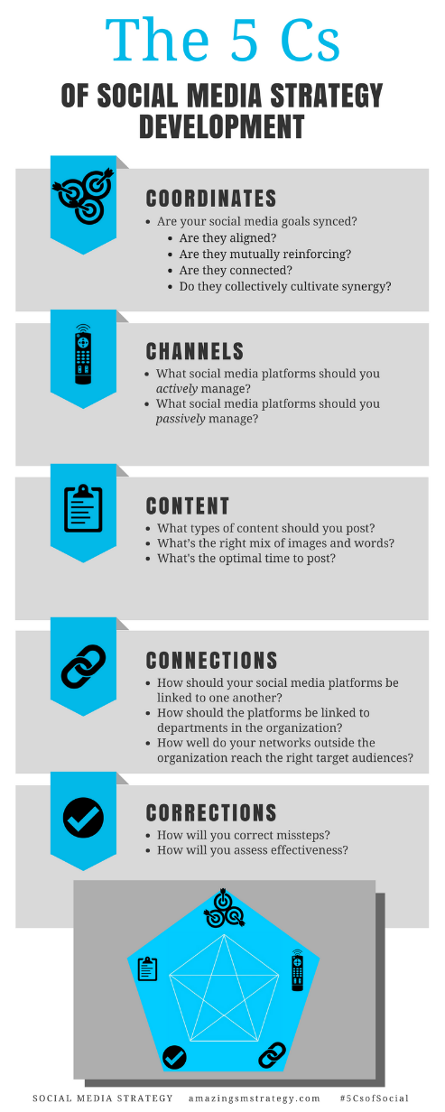
The 5 Cs of Social

Slide 14
Social Media
Strategy
Tools for Professionals and Organizations
#5CsofSocial

