Slide 1
What are the Benefits of a Social Media Strategy?
Chapter 3

Slide 2
Agenda
How does a sound strategy…
1. Help guide deployment of resources?
2. Help coordinate people and resources?
3. Educate employees in the organization?
4. Provide stability during tumultuous times and crises?
www.amazingSMstrategy.com • #5CsofSocial

Slide 3
1. Helps guide deployment of resources
All resources are limited
They need to be deployed in the most cost-effective way
On what social media platforms should we concentrate our time and attention?

Slide 4
2. Helps coordinate people and resources
Facilitates getting everyone “on the same page”
Controls the agenda for discussions in the organization
For example: the Assess and Respond Strategy
Notes:
See the book for details on the Assess and Respond Strategy

Slide 5
3. Educate employees
Helps employees to…
Understand the underlying dynamics of social media platforms
Identify the characteristics of effective and ineffective strategies
Design strategies and tactics to create social media success
Evaluate existing social media strategies and tactics

Slide 6
4. Provides stability during tumultuous times and crises
“The value of having a strategy is that you don’t have to wake up every day and ask yourself basic questions about the best course of action. Well-chosen strategic ideas do not require frequent revision. They help fix your course and guide tactical choices, even as events unfold in unanticipated ways—as events always do.”
- Douglas Feith, former Undersecretary of Defense for Policy
Notes:
See p. 33 in the book for the quote

Slide 7
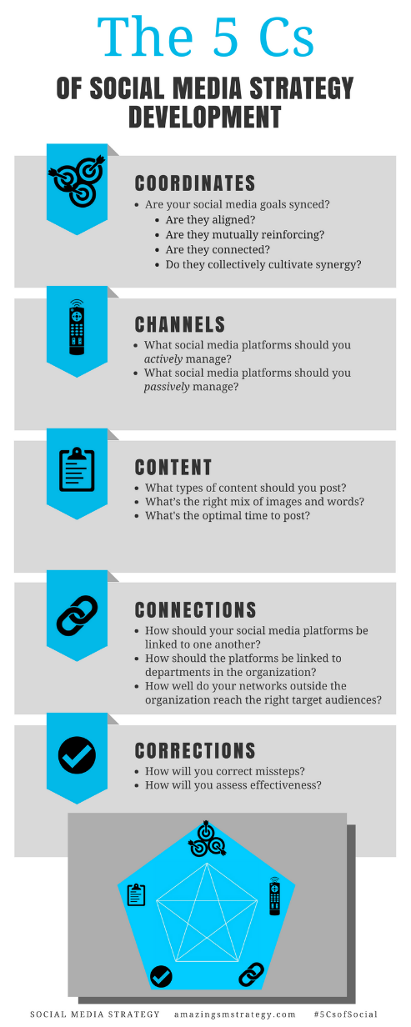
The 5 Cs of Social

Slide 8
Social Media
Strategy
Tools for Professionals and Organizations
#5CsofSocial

