Slide 1
What is a Social Media Strategy?
Chapter 2

Slide 2
Agenda
What does NOT count as a social media strategy?
How do you create a superior social media strategy?
Why craft a social media strategy?

Slide 3
1. What does NOT count as a social media strategy?
Strategy is NOT a single idea, although it often arises from a simple basic notion
Strategy is NOT stationary, although it does provide a degree of stability
Strategy is NOT abstract, although it may initially appear to be
Strategy is NOT a tool, although you may use tools to arrive at one
Strategy is NOT a plan, although plans certainly emerge from it

Slide 4
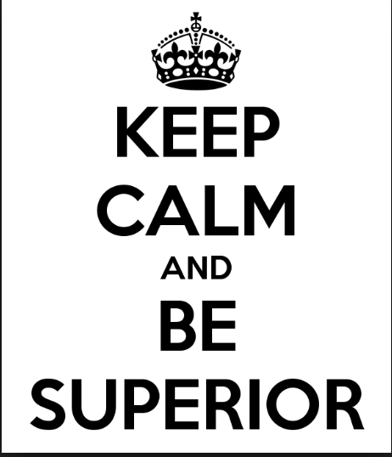
2. How do you create a superior social media strategy?
Assess the competitive landscape
Make big-picture choices
Coordinate the choices
Set a coherent path forward
Craft an orchestrated set of tactics

Slide 5
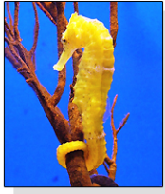
Assess competitive landscape
Sea Horse – Why does it have a square tail?
Provides protection
Enables grasping capability
The bottom line: body is well suited for the environment
“Good strategy grows out of an independent and careful assessment of the situation, harnessing individual insight to carefully crafted purpose. Bad strategy follows the crowd, substituting popular slogans for insights.” - Richard Rumelt
Notes:
The sea horse is perfectly adapted to its environment…and that’s what good strategies do.
Richard Rumelt, from the UCLA Anderson School of Business and the author of Good Strategy/Bad Strategy, is the foremost authority on business strategy and he echoes this sentiment.

Slide 6
Make big picture choices
World War II – Pearl Harbor
Andy Grove – Intel
Helen Keller –
“If I regarded my life from the point of view of a pessimist, I should be undone. I should seek in vain for the light that does not visit my eyes and the music that does not ring in my ears. I should beg night and day and never be satisfied. I should sit apart in awful solitude, a prey to fear and despair. But since I consider it a duty myself and other to be happy, I escape a misery worse than any physical deprivation.”
Notes:
These points are reviewed in the book and highlight how strategic thinking can apply to government policy, business plans and personal philosophy

Slide 7
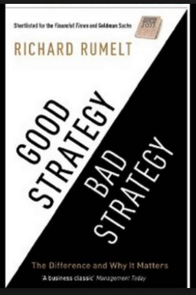
“A good strategy draws power from focusing minds, energy, and action. That focus, channeled at the right moment onto a pivotal objective, can produce a cascade of favorable outcomes.”
—Richard Rumelt

Slide 8
Big picture … social media choices
Coordinates – What are your orienting goals? What are their relationships with one another?
Channels – What social media platforms should you actively manage? Passively manage?
Content – What types of content should you post? What’s the right mix of images and words? In general, when should you post?
Connections – How should your social media be connected to one another, other organizational departments, executives, and decision-making processes?
Corrections – How will you assess effectiveness and correct missteps?

Slide 9
Coordinate the choices
Coordinates
Channels
Corrections
Connections
Content
Notes:
Note how they are all linked to Coordinates….but is something missing??

Slide 10
Coordinate the choices
Coordinates
Channels
Corrections
Connections
Content
Was something missing?
Notes:
Each has to be linked to the other and ’synced’
For example, you have to have the right content for a particular channel

Slide 11
Coordinate the choices
Example 1
Encourage people to buy your product/service (a Coordinate)
Fail to link social media to website (Connections)
Example 2
Position yourself as a thought leader (a Coordinate)
Select LinkedIn & Twitter as primary social media platforms (Channels)
Notes:
In Example 1, if a company wants to encourage people to buy products or services (a strategic goal/coordinate), they need to link their social media efforts with their website (a Connections issue). In fact, in a recent study we conducted, we found that 68% of social media specialists regarded “driving traffic to our website” as a high priority and 14% regarded it as a secondary priority.
In Example 2, thought leaders, particularly in business, use LinkedIn contacts to position themselves as “go-to” people on particular issues.

Slide 12
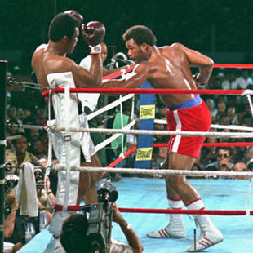
Rope-a-Dope
In 1974, Ali challenged George Foreman, who had dethroned Frazier in 1973 to become heavyweight champion of the world.
Instead of moving around the ring, Ali chose to fight for extended periods of time leaning back into the ropes in order to avoid many of Foreman’s heaviest blows. This came to be known as his “Rope-a-dope” strategy.
Ali-Rope-a-dope

Slide 13
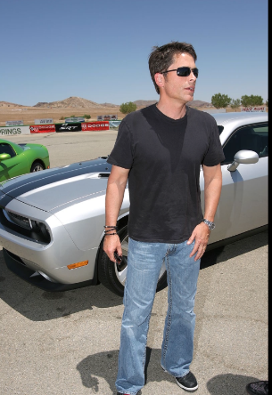
Set a coherent path forward
Tick-Tock Apple Strategy
Rob Lowe – Speed Bump Strategy
Does it need to be said?
Does it need to be said by me?
Does it need to be said now?
Notes:
See the book for details

Slide 14
Craft an orchestrated set of tactics

Slide 15
3. Why craft a social media strategy?
What works in your personal world may not translate well into the professional universe
Most people are victims rather than masters of their own de facto strategies and rarely seize on new opportunities
De facto and emergent strategies are rarely recognized, much less evaluated
“I don’t have a telephone strategy; why would I need a social media strategy?”
So…
Why do you answer certain phone calls and not others?
When do you typically terminate phone conversations? Why?
What matters do you choose to discuss face-to-face rather than on the phone?
How do you recall the content of conversations?
With whom do you choose to share (and not share) your phone number? Why?
Notes:
See book for details

Slide 16
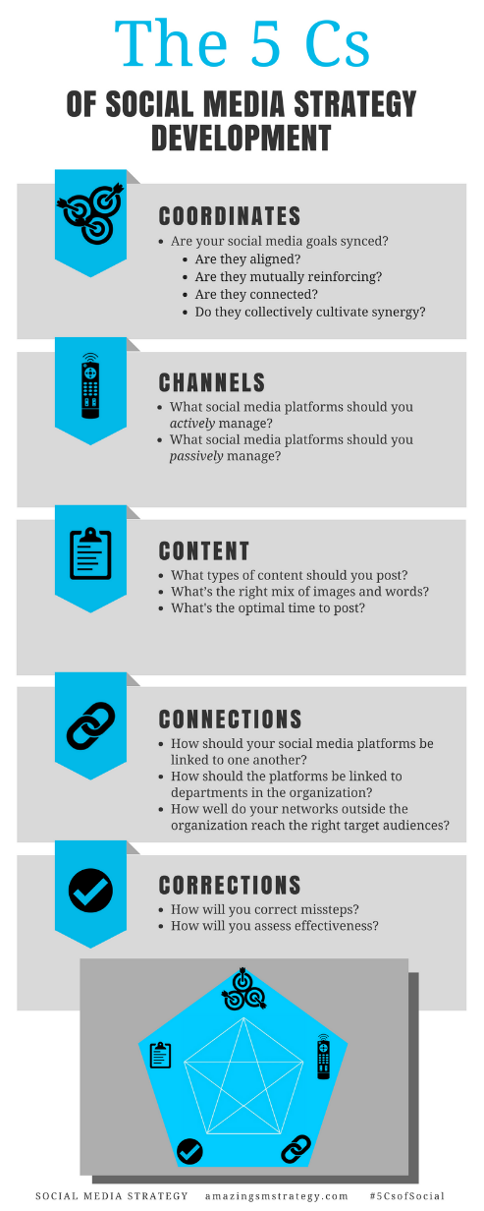
The 5 Cs of Social

Slide 17
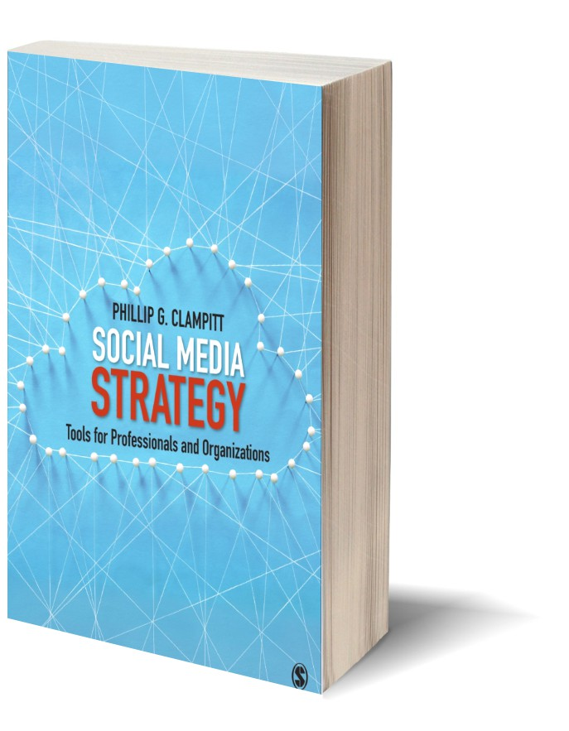
Social Media
Strategy
Tools for Professionals and Organizations
#5CsofSocial

