Slide 1
Crafting the Social Media Assessment Report
Chapter 14

Slide 2
Part III: Assessing results

Slide 3
Agenda
What are some principles to take into account when drafting the report ?
What are the main sections of the assessment report?

Slide 4
Adapt the report to your audiences
Use the right comparison points/provide context for the stats you share
Aim to provide an ROI
Highlight connections between your social media platforms and other communication tools
1. What principles should you take into account when drafting the report?
Notes:
See the book for details
For example:
*Adapt to your audiences: consider their usage level of social media, their knowledge level of social media, their understanding of your goals
*Aim to provide an ROI – attempt to come up with some solid measure of the costs of your social media efforts relative to the benefits the firm derives
*Highlight connections: discuss what is occurring on other communication channels as you pursued your social media activities

Slide 5
Executive Summary
Introduction
Limitations
Comparative Framework
Data and Analysis
Success Stories
Conclusions and Recommendations
Appendixes
2. What are the main sections of the assessment report?
Notes:
The Executive Summary was not specifically noted in the book. However, as some executives may not take the time to read the entire report, a one-page summary of the key points of the report is often helpful to include in the beginning of the report.

Slide 6
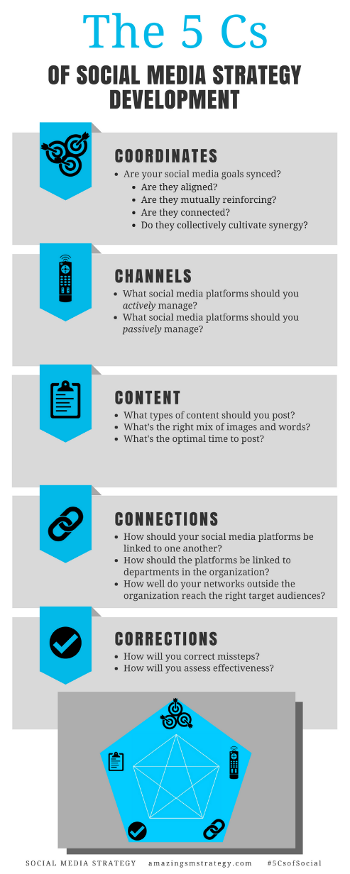
The 5 Cs of Social

Slide 7
Social Media
Strategy
Tools for Professionals and Organizations
#5CsofSocial

