Slide 1
Connections
The least visible C of the #5 Cs of Social Chapter 9

Slide 3
Agenda
Definition and key terms
What are some ways of classifying connections?
The Connections Matrix
What are some tips in crafting a connections strategy?
How do you judge effectiveness?
www.amazingSMstrategy.com • #5CsofSocial

Slide 4
Some perspective
“Pathways act as an essential guiding force on this planet: on every scale of life, from microscopic cells to herds of elephants, creatures can be found relying on trails to reduce an overwhelming array of options to a single expeditious route. Without trails, we would be lost. …the soul of a trail –its trail-ness – is not bound up in dirt and rocks; it is immaterial, evanescence, as fluid as air. The essence lies in its function: how it continuously evolves to serve the needs of its users.”
Robert Moor
www.amazingSMstrategy.com • #5CsofSocial
Notes:
This slide sets the tone and provides perspective to students.

Slide 5
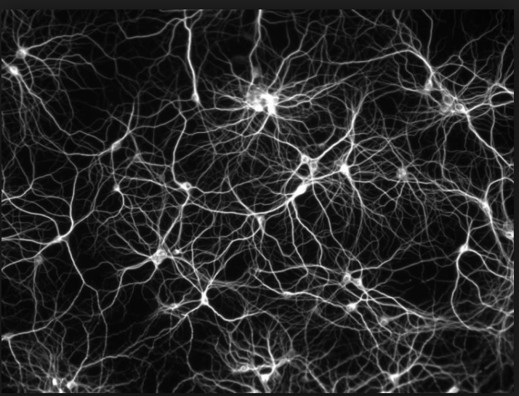
1. Definition and key terms
What are connections?
The links between nodes that form networks
Key terms
Nodes – points of reference (people, cities, cell phones)
Links – pathways connecting nodes
Networks – patterns formed by pathways

Slide 6
Nodes
Examples
Traditional media (e.g., print, kiosks, menus, advertisements)
Decision-making points (e.g., resolving customer service complaints, researching markets)
Partner advertisements (e.g., website of an company selling your products or services)
The key node: Bull’s-eye node
Notes:
Examples of types of nodes. The images are typical bull’s-eye nodes.

Slide 7
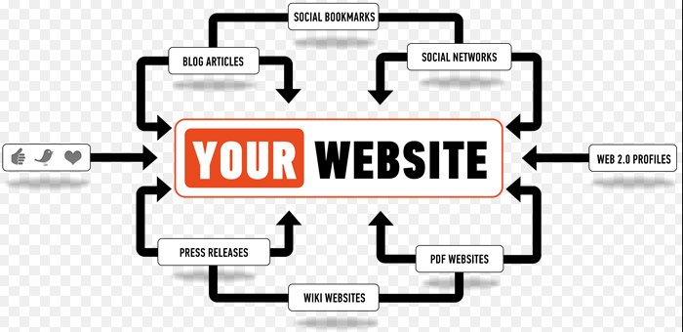
Links
Characteristics
Direction
One-way
Two-way
Volume – Typical traffic
Capacity – The upper limit of the volume

Slide 8
Networks
Characteristics
Hubs – Centralized nodes
Example: O’Hare Airport (centralized)
Very important in networks
Hinges – Connect separate groups
Path length – Amount of separation between nodes
How long does it take for the signal to get from one point to another?
Types (see following slides)
Notes:
See following slides for examples

Slide 9
Centralized network
Hub: Red dot
Path link from A to B: 2

Slide 10
Decentralized network
Hinge (& hub): Red node
Path link from A - B: 5 is shortest route

Slide 11
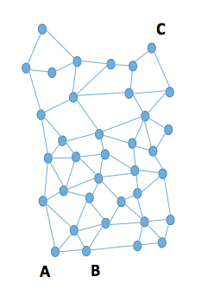
De-centralized vs. Distributed
Distributed network
Decentralized
But many pathways between A & B
Notes:
All distributed networks are decentralized but not all decentralized networks are distributed. The reason? There are many pathways between nodes in a distributed network. Decentralized have fewer pathways and more hinge points.

Slide 12
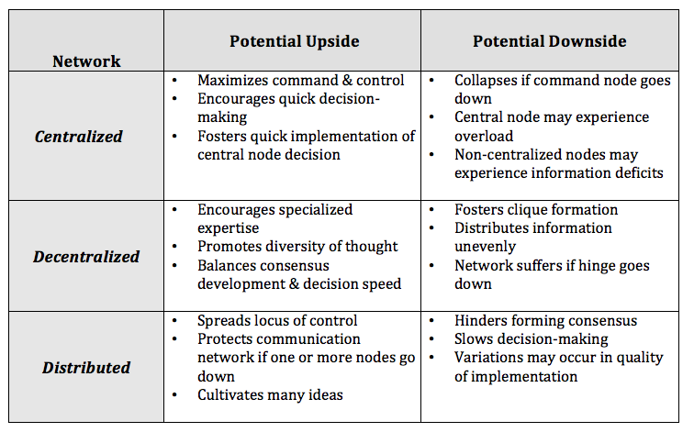
Network Principles
There are tradeoffs associated with every type of network
Networks have both structural and emergent properties

Slide 13
2. What are some ways of classifying connections?
Quantity: many to few
Strength: strong to weak

Slide 14
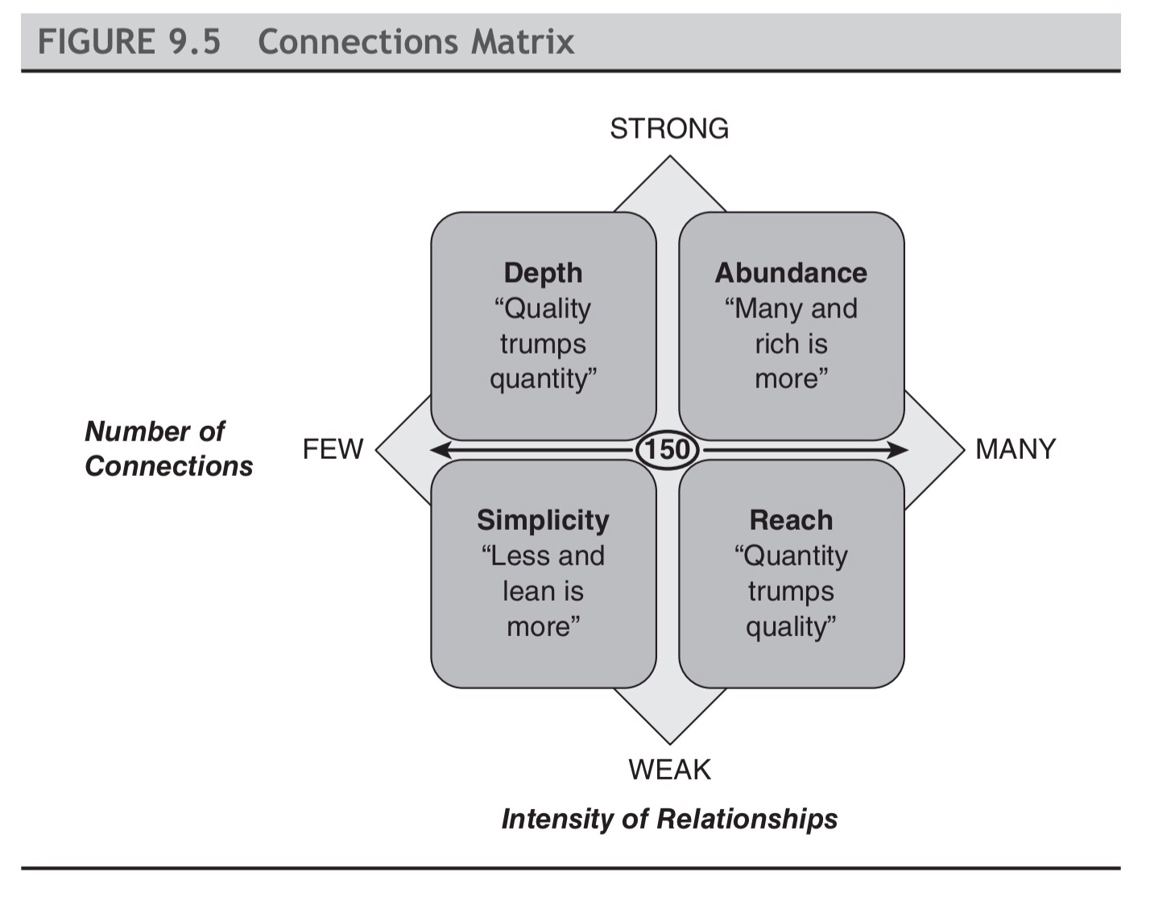
3. The Connections Matrix

Slide 15
4. What are some tips in crafting a connections strategy?
Mix and match connection strategies
Develop skill sets associated with each strategy
For example,
Reach strategy (see next slide)
Depth strategy
Recognize the costs and benefits of each connection strategy
Notes:
1. A B2B strategy is often very different than B2C. For example, B2B might benefit more from a depth strategy instead of reach, while B2C might be the reverse. 2. For example, with a reach strategy, consider the following ideas: Automaticity – Selecting images, colors or sounds designed to automatically capture our attention.
Framing – Shifting the way we normally view of a subject.
Disruption – Violating our expectations in some unusual way
Mystery – Creating suspense or uncertainty that begs to be resolved.
Reward – Promising an external or internal reward.
Reputation – Using the credibility of experts, celebrities, or historical figures to seize attention.
3. See next slides

Slide 16
Reach strategy attention-getting ideas
Automaticity – Selecting images, colors or sounds designed to automatically capture our attention
Framing – Shifting the way we normally view of a subject
Disruption – Violating our expectations in some unusual way
Mystery – Creating suspense or uncertainty that begs to be resolved
Reward – Promising an external or internal reward
Reputation – Using the credibility of experts, celebrities, or historical figures to seize attention
Notes:
This list categorizes different ways to capture user attention that work well with the Reach strategy.

Slide 17
Costs and benefits of the Connections Matrix strategies

Slide 18
Costs and benefits (cont’d)

Slide 19
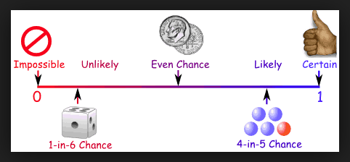
5. How do you judge effectiveness?
Judge effectiveness based on your strategy
Example: The number of followers is not particularly important with a Depth strategy but it is for a Reach strategy
Judge effectiveness based on ease of reaching the ”bull’s-eye” nodes
Judge effectiveness based on probabilities
Ask what are the probabilities or likelihood of success? If you “spray” messages to a large number of people and “pray” for returns, then you can expect about 1% - 3% return rate. Anything above that is a considered a success.
You can expect trolls when you send out messages to a large number of people
You should expect lower engagement from a Reach strategy than from a Breadth strategy

Slide 20
Judging effectiveness cont.
Determine how your audiences are actually making use of their connections
More than 40% of consumers say that information found via social media affects the way they deal with their health (Source Mediabistro)
90% of respondents from 18 to 24 years of age said they would trust medical information shared by others on their social media networks (Source Search Engine Watch)
Analyze the links between social media platforms (see next slides)

Slide 21
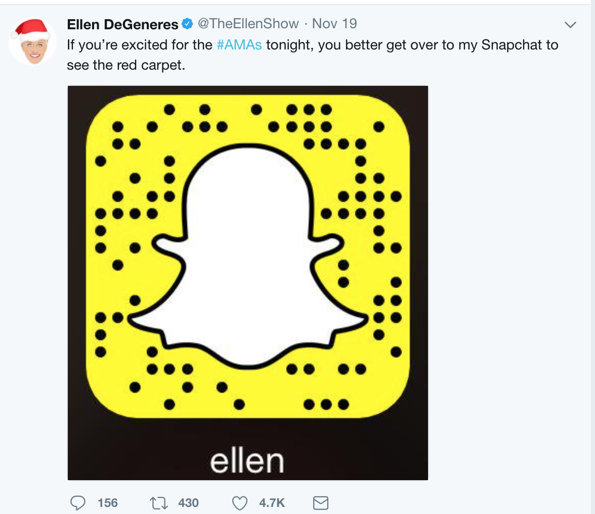
Examples of optimizing links

Slide 22
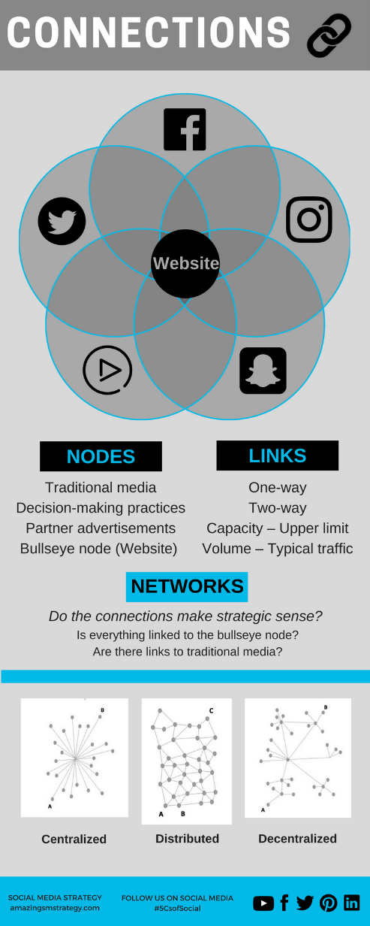
Tips and reminders

Slide 23
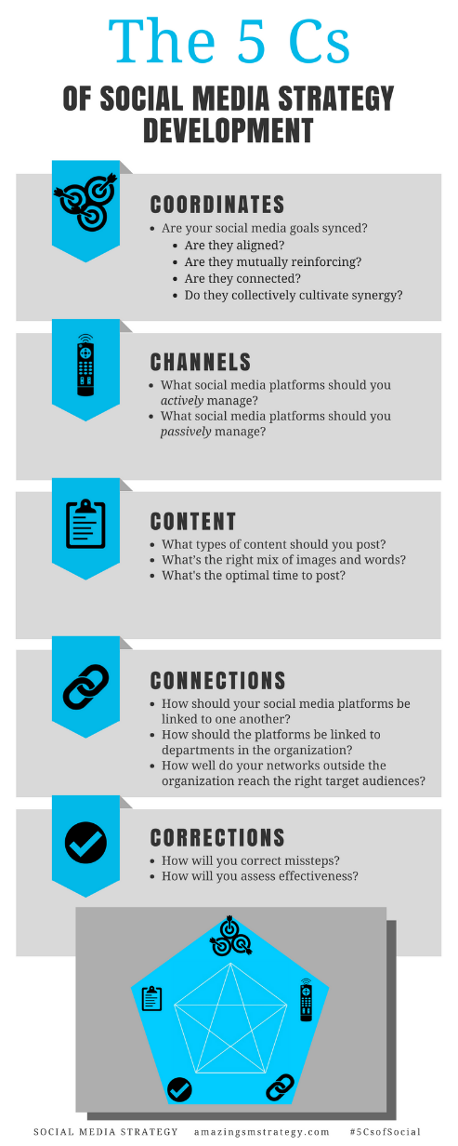
The 5 Cs of Social

Slide 24
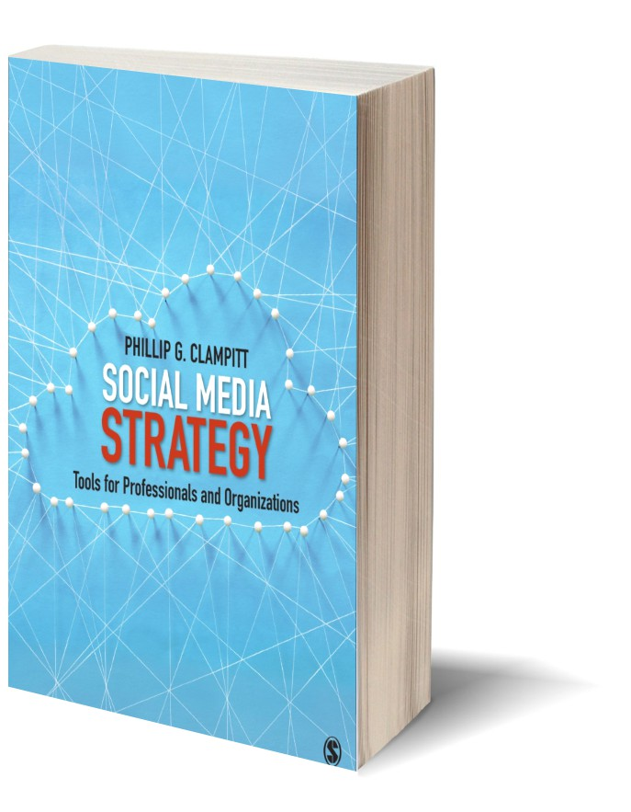
Social Media
Strategy
Tools for Professionals and Organizations
#5CsofSocial

