Slide 1
Coordinates
The Orienting C of the #5 Cs of Social
Chapter 6

Slide 2
Agenda
What are coordinates?
What are some possible combinations and outcomes of goals that are good/bad, synced/not synced?
What are the benefits of establishing sound coordinates?

Slide 3
1. What are coordinates?
Good strategic goals that are synced with one another
Strategic goals:
Represent big picture choices
Define the operating space
Notes:
We know that establishing your goals is a starting point for a task – but we take this one step further – we are looking for goals that work together/that are “synced”
You’ll note some of the words are italicized -- these are worthy of a bit more detail:
Strategic goals:
They represent big picture choices that an organization makes and which then define its operating space
Because the organization’s resources are limited (time, money, expertise, etc.), it must make wise choices about what to do and what not to do – in other words, what the organization pursues and what it doesn’t pursue
And what this means is that It may not pursue some enticing goals in favor of something even more valuable that leverages the organization’s strengths

Slide 4
Examples of Social Media Goals
Notes:
These are a results from a study of over 50 social media managers. See http://amazingsmstrategy.com/goals-competencies-and-challenges-of-successful-social-media-specialists-2/
This study is available on the Amazing-Social 5 Cs Blog.

Slide 5
Good goals have these characteristics
Notes:
In our definition, we note “good” goals – or ”sound” goals. So, another feature of coordinates is that they have these characteristics:

Slide 6
Synced goals have these characteristics
Notes:
We also noted that coordinates are SYNCED goals –
We use the Acronym “ARCS” to serve as a helpful reminder – so, synced goals are:
*Aligned with one another
*They are mutually reinforcing
*They are connected to one another
*And together, they cultivate a certain type of synergy
In other words, they work together

Slide 7
For example…
Your mission: Promote an organizational event
Goals
Establish a website highlighting the successes of your organization
Craft a social media campaign designed to promote the event
Are the above linked with one another?
But…adding this third goal creates a “sync”
Integrate event promotion on the website and on social media outlets
Notes:
For example, if we assume your mission is to promote an event for your organization,
You might have 2 goals:
Establish a website highlighting the successes of your company
Craft a SM campaign to promote the event
*For time and space purposes, let’s assume that these goals are more specifically defined to capture the SMART characteristics
So, they’re fine by themselves, but there’s really no linkage or connection between the 2 of them
But when you add a third goal, “Integrate the promotion of the event on the org’s website and on social media platforms”, there is some synergy between them – they are coordinated – they are coordinates

Slide 8
2. What are some possible combinations and outcomes?
Organizational MIssion
Good Goals
Bad Goals
Synced Coordinates
Unsynced Mismatches
Synced Toxic Alliances
Unsynced Total Flops
Notes:
So far, we’ve made a distinction between good vs. bad goals AND synced vs. not synced goals
Let’s take a look at what might emerge as a result of these combinations:
First of all, what drives all the goals is the organizational mission
So, if we start on the bottom right side, we have:
*bad goals (goals that are missing one of the SMART characteristics – timed, actionable, measurable -- that are unsynced = total flops;
*bad goals that are synced = toxic allliances
Then moving over to the left, we have:
*sound goals that are unconnected to each other = mismatches
*and finally, sound goals that are connected to one another = coordinates
And some examples follow…

Slide 9
Some examples of possible combinations and outcomes
Total Flops
Your mission: Enhance the reputation of your organization
Goals
Post more pictures of your products on Facebook
Post financials from your annual report on organization’s Twitter account
Toxic Alliances
Your mission: Create more visibility for new products
Goals
Post more pictures of your products on Facebook that you also post on your company’s Pinterest account
Frequently alert followers on Facebook and Twitter about the new pictures of your products
Notes:
Let’s first look at the “Bad” goals area of the chart, where the goal is missing one of the SMART characteristics – it’s not specific, measureable, actionable, realistic, timed
Starting with total flops which are: goals that are also missing one of the SMART characteristics and they don’t work together
In this case, your mission is to “enhance the reputation of your organization, and you have 2 goals: post more pictures of your products on FB AND post financials from your annual report on your company’s Twitter account.
Right off the bat, you notice that this violates the “realistic” characteristic because using FB and Twitter for this is inappropriate. And, as they stand now, they are not connected or mutually reinforcing – posting your financials is not related to your products - They don’t work together
Moving to toxic alliances which are: goals that are missing one of the SMART characteristics but they are synced – they work together.
Let’s assume your mission is to create more visibility for new products and your goals are to: 1) post pix of products on FB that are also posted on the company’s Pinterest account AND 2) alert FB and Twitter followers about the pix of your products
So, in this case, you’ll note that the first goal is similar to the previous example, and it remains an inappropriate use of FB and Pinterest, BUT
they are aligned, they are connected – they do reinforce one another

Slide 10
Some examples of possible combinations and outcomes
Mismatches
Your mission: Increase sales of your brand
Goals
Drive traffic to your company’s website to encourage sales
Increase awareness of the brand through Twitter by live-streaming events
Coordinates
Your mission: Increase sales of your brand
Goals
Drive traffic to your company’s website to encourage sales
Increase awareness of the brand through Twitter by live-streaming events
Highlight the links to your website on your live-streaming events
Notes:
Moving to the “Good” goals area of the chart, where we’ll assume for time and space purposes that the goals have the SMART characteristics, we have:
Mismatches, where the “good” goals are not connected to one another – they’re independent:
So, your mission is to increase sales of your brand and your goals are: 1) to drive traffic to your website to encourage sales and 2) Increase awareness of your brand by using Twitter to live-stream events
Those are appropriate usages of the platforms…but as they stand at this point, there is really no connection between the two –
If you think of this in terms of a sports team analogy, You may have excellent, skilled players BUT they just don’t gel – they don’t play together well – there’s something missing
Coordinates – So if we extend on the previous example by adding a third goal, Highlighting the links to your website on your live-streaming events, we see that they are now connected – they’re synced – they work in concert - coordinated – they are coordinates

Slide 11
3. What are the benefits of establishing sound coordinates?
So what does establishing sound coordinates allow you to do?
Provides focus and definition on where you want to compete in the social media universe
Provides springboard to make decisions about the other Cs (channels, content, connections and corrections)
Provides a mechanism by which to judge your effectiveness
Notes:
By establishing sound, synced goals, it provides direction for all team members involved in any initiative -- a point of focus –
It’s also the starting point – or springboard -- to make decisions about what channels to use, what to post, your networks/connections and your corrections management approach
it also provides a means by which to measure your success – we have our specific, measurable, actionable, realistic and timed goals that are nicely connected to one another --are we achieving them?

Slide 12
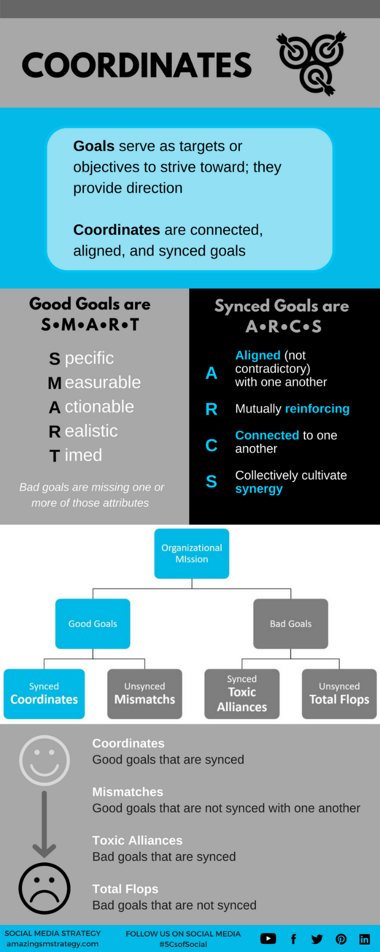
Tips and reminders
Notes:
These infographics are also available on the book’s website under the “Fun” tab

Slide 13
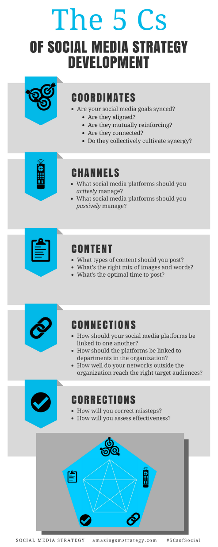
The 5 Cs of Social

Slide 14
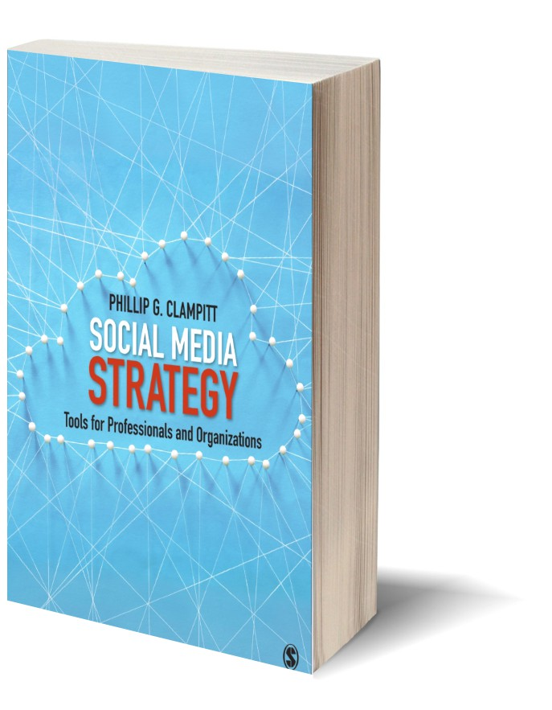
Social Media
Strategy
Tools for Professionals and Organizations
#5CsofSocial

