Slide 1
The Mindset of a Strategist, the Sensibilities of a Professional, & the Zeal of an Enthusiast
Chapter 15

Slide 3
Agenda
Strategic Mindset
Professional Sensibilities
Enthusiast's Zeal

Slide 4
Social media strategists…
Are grounded by reality even as they envision the next steps forward
Focus on making the right trade-offs
Cultivate synergies
1. Strategic mindset
Notes:
See the book for details
For example:
*Adapt to your audiences: consider their usage level of social media, their knowledge level of social media, their understanding of your goals
*Aim to provide an ROI – attempt to come up with some solid measure of the costs of your social media efforts relative to the benefits the firm derives
*Highlight connections: discuss what is occurring on other communication channels as you pursued your social media activities

Slide 5
Professional sensibilities
Social media professionals…
Are committed to a core set of values and related ethical standards
Cultivate collaborative, respectful relationships with others in their organizations
Exercise good judgment
2. Professional sensibilities

Slide 6
Social media enthusiasts…
Have fun (but, within limits)
consider the following exchange:
Piers Morgan tweets to model Emily Ratajowski on her photo shoot: “Do you want me to buy you some clothes? You look freezing.”
Ratajowski replies: ”@piersmorgan thanks, but I don’t need clothes as much as you need press”
3. Enthusiast's Zeal

Slide 7
Enthusiast’s zeal
Social media enthusiasts…
Devour the latest news and trends in their field
“…the only thing forbidden should be to stand still and say, ‘This is it’” - Robert Grudin
Experiment
Enthusiast’s zeal (cont’d)

Slide 8
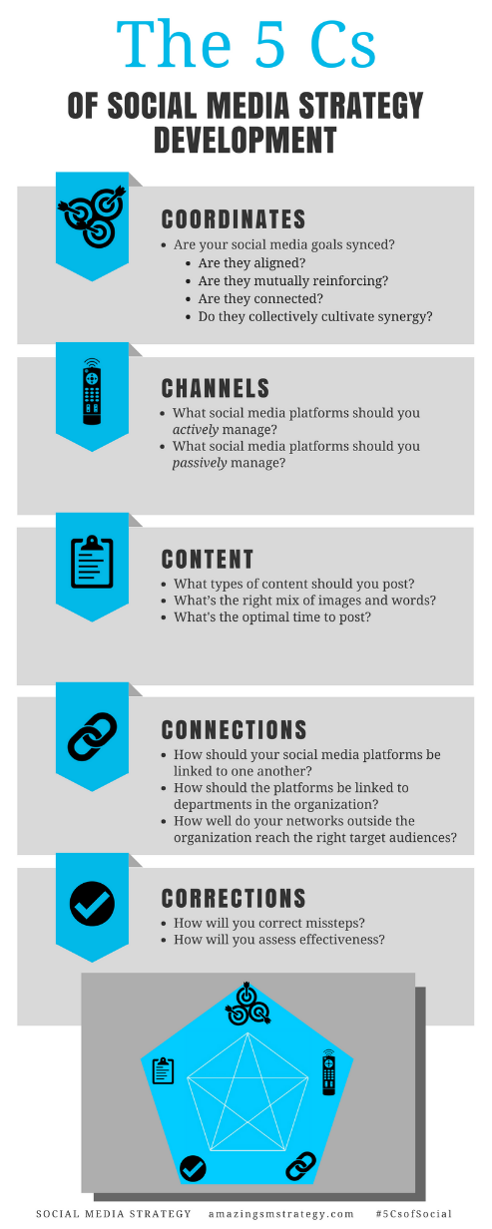
The 5 Cs of Social

Slide 9
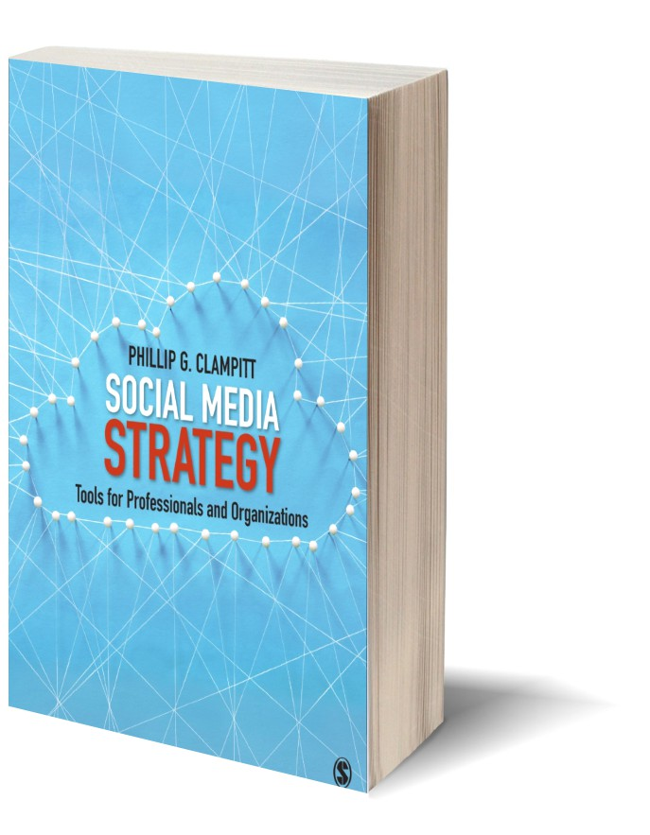
Social Media
Strategy
Tools for Professionals and Organizations
#5CsofSocial

